Slide 1
2017 Plains Region Portfolio

Slide 2

2017 Plains Region Portfolio

Slide 3



Norfolk Division
2001 Riverside Blvd.
Norfolk, NE 68701
(402) 371-9347 or (866) 248-7645
Fax: (866) 592-3774
 | Mick Lusero Omaha Branch Manager Michael.Lusero@dpsg.com (402) 505-2634
Jonathan Grimm Distribution Supervisor Jonathan.Grimm@dpsg.com (402) 860-1472 |  |  |  | Brian Buresh Warehouse Supervisor Brian.Buresh@dpsg.com (402) 860-0757
Rick Anderson Vending Department Ricky.Anderson@dpsg.com (402) 616-5777 |  |  |  | Jennifer Risinger Administrative Assistant Jennifer.Risinger@dpsg.com (402) 371-9347
 | Danny Olson Sales – Yankton/Wayne – Northern Region Danny.Olson@dpsg.com (402) 649-6681
 | Scott Weinrich Sales – Norfolk/West Point – Central Region Scott.Weinrich@dpsg.com (402) 750-5365
 | Randy Walnofer Sales – Columbus/Schuyler – Southern Region Randy.Walnofer@dpsg.com (402) 992-9101
TO PLACE AN ORDER plains_orders@dpsg.com (866) 592-3774, option #1 |  |  | For equipment service: plains_equipmentservice@dpsg.com (866) 592-3774, option #2
Please include your account number and business name

Slide 4
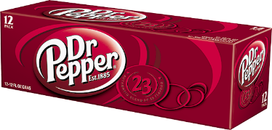
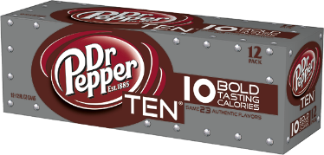
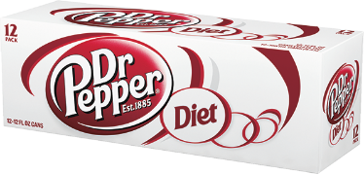
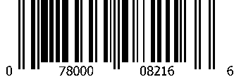
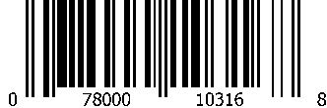
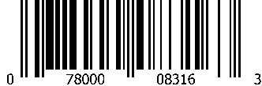
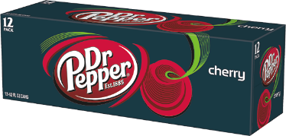
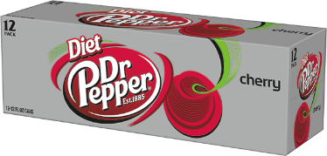
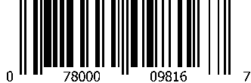
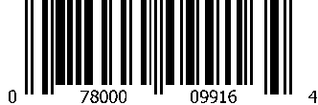
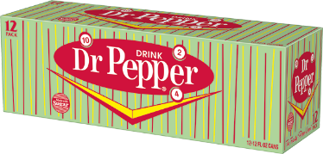
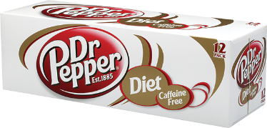


CSD 12oz Cans (2x12pk)
 | Dr Pepper |  | Dr Pepper TEN |  | Diet Dr Pepper
 | 1000 0836 Deposit 1000 2434 No Deposit |  | 1000 3730 |  | 1000 1754 Deposit 1000 2435 No Deposit
 | 0-78000-08216-6 |  | 0-78000-10316-8 |  | 0-78000-08316-3
 | Cherry Dr Pepper |  | Diet Cherry Dr Pepper
 | 1000 1749 |  | 1000 1750
 | 0-78000-09816-7 |  | 0-78000-09916-4
 | Dr Pepper Real Sugar |  | Diet Caffeine Free Dr Pepper
 | 1000 2778 |  | 1000 0835
 | 0-78000-10216-1 |  | 0-78000-08516-7

Slide 5
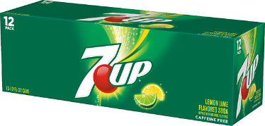
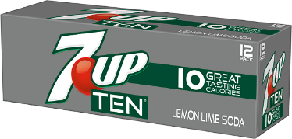
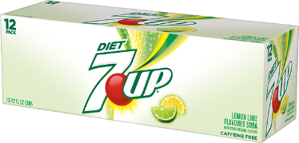
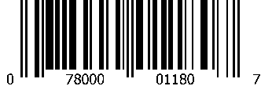
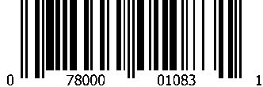
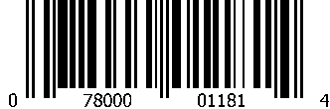
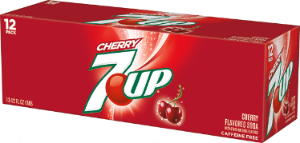
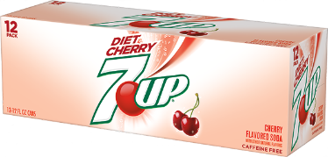
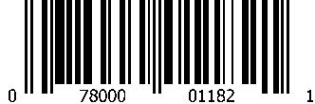
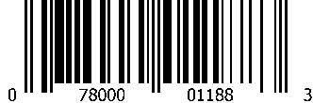
CSD 12oz Cans (2x12pk)
 | 7Up |  | 7Up TEN |  | Diet 7Up
 | 1000 0829 Deposit 1000 2431 No Deposit |  | 1002 0900 |  | 1000 0830 Deposit 1000 2432 No Deposit
 | 0-78000-01180-7 |  | 0-78000-01083-1 |  | 0-78000-01181-4
 | Cherry 7Up |  | Diet Cherry 7Up
 | 1000 0833 |  | 1000 0834
 | 0-78000-01182-1 |  | 0-78000-01188-3

Slide 6
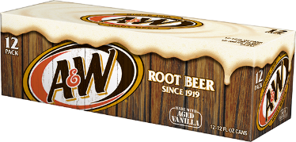
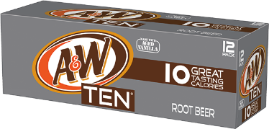
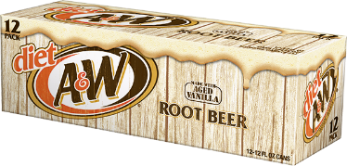

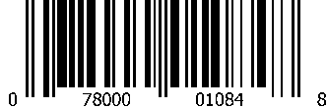
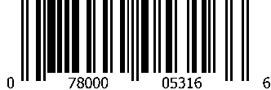
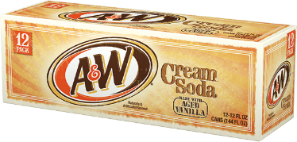
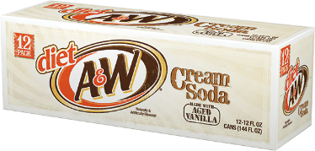
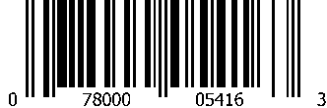
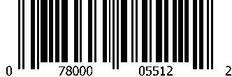
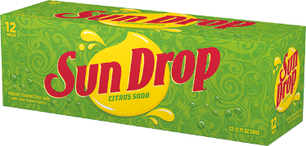
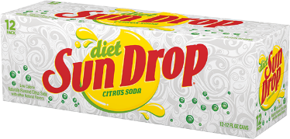
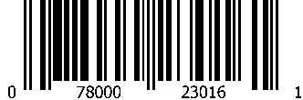
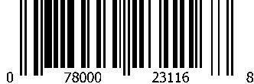
CSD 12oz Cans (2x12pk)
 | A&W Root Beer |  | A&W TEN |  | Diet A&W Root Beer
 | 1000 0852 Deposit 1000 2456 No Deposit |  | 1002 0903 |  | 1000 0853
 | 0-78000-05216-9 |  | 0-78000-01084-8 |  | 0-78000-05316-6
 | A&W Cream Soda |  | Diet A&W Cream Soda
 | 1000 0831 |  | 1000 0832
 | 0-78000-05416-3 |  | 0-78000-05512-2
 | Sun Drop |  | Diet Sun Drop
 | 1000 0874 |  | 1000 0877
 | 0-78000-23016-1 |  | 0-78000-23116-8

Slide 7

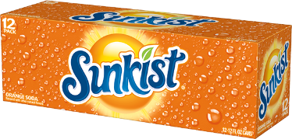
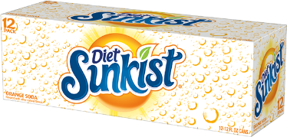
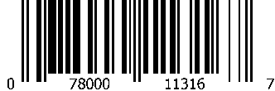
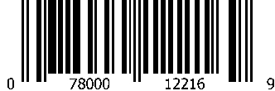
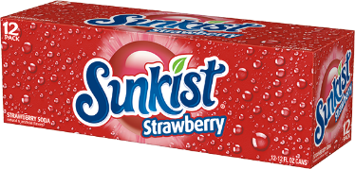
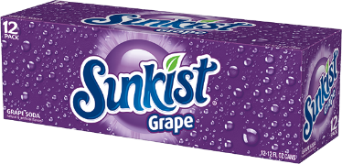
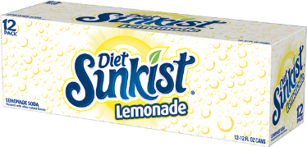

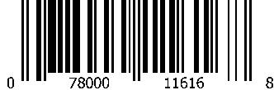

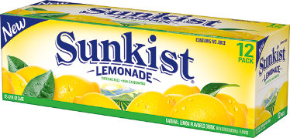
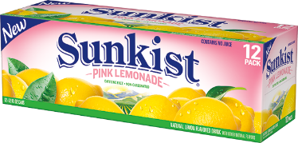
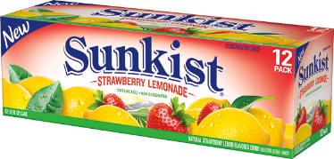

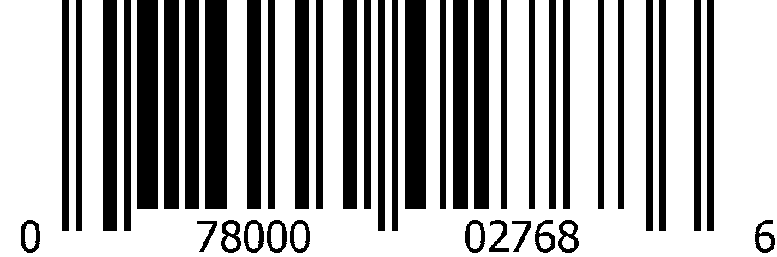
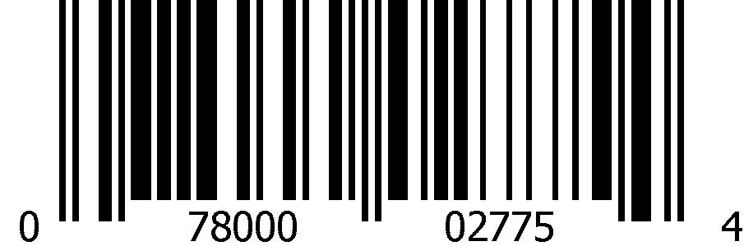
CSD 12oz Cans (2x12pk)
 | Sunkist Orange |  | Diet Sunkist Orange
 | 1000 0865 Deposit 1000 2457 No Deposit |  | 1000 0863
 | 0-78000-11316-7 |  | 0-78000-12216-9
 | Sunkist Strawberry |  | Sunkist Grape |  | Diet Sunkist Sparkling Lemonade
 | 1000 1700 |  | 1000 1699 |  | 1000 0864
 | 0-78000-11816-2 |  | 0-78000-11616-8 |  | 0-78000-12816-1
 | Sunkist Lemonade |  | Sunkist Pink Lemonade |  | Sunkist Strawberry Lemonade
 | 1008 7790 |  | 1008 7798 |  | 1009 0327
 | 0-78000-02763-1 |  | 0-78000-02768-6 |  | 0-78000-02775-4

Slide 8
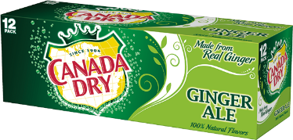
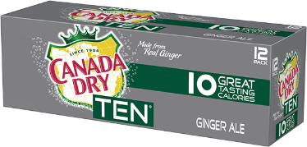














CSD 12oz Cans (2x12pk)
 | Canada Dry Ginger Ale |  | Canada Dry TEN |  | Canada Dry Diet Ginger Ale
 | 1000 0904 |  | 1002 0905 |  | 1000 0905
 | 0-78000-15216-6 |  | 0-78000-01114-2 |  | 0-78000-14816-9
 | Canada Dry Cranberry Ginger Ale |  | Canada Dry Blackberry Ginger Ale
 | 1000 1994 |  | 1008 6453
 | 0-78000-15616-4 |  | 0-78000-02608-5
 | Squirt |  | Diet Squirt |  | Ruby Red Squirt
 | 1000 0187 |  | 1000 0850 |  | 1000 0860
 | 0-78000-01616-1 |  | 0-78000-01716-8 |  | 0-78000-01816-5

Slide 9














CSD 12oz Cans (2x12pk)
 | Vernors |  | Diet Vernors
 | 1000 0840 |  | 1000 0841
 | 0-78000-18016-9 |  | 0-78000-18216-3
 | Hawaiian Punch Fruit Juicy Red |  | Tahitian Treat
 | 1000 0855 |  | 1002 3856
 | 0-78000-04052-4 |  | 0-78000-02025-0
 | Sunny D Citrus Punch |  | Hires Root Beer |  | Nehi Peach
 | 1000 0878 |  | 1000 0851 |  | 1000 0180
 | 0-50200-00148-2 |  | 0-41710-41350-6 |  | 0-29500-26295-4

Slide 10










CSD 12oz Cans (2x12pk)
 | Big Red |  | Big Red Zero
 | 1000 0862 |  | 1000 0880
 | 0-71817-03329-1 |  | 0-71817-03330-7
 | Diet Rite Cola
 | 1000 0842
 | 0-78000-06316-5
 | RC Cola |  | Cherry RC Cola
 | 1000 0838 |  | 1000 0179
 | 0-78000-04116-3 |  | 0-78000-04416-4

Slide 11









CSD 12oz Cans (2x12pk)
 | Crush Orange |  | Diet Crush Orange
 | 1002 1944 |  | 1002 1945
 | 0-78000-01305-4 |  | 0-78000-01389-4
 | Crush Grape |  | Crush Strawberry
 | 1002 1904 |  | 1002 1907
 | 0-78000-01345-0 |  | 0-78000-01362-7

Slide 12












Sparkling Waters 12oz Cans (2x12pk)
 | Canada Dry Sparkling Original |  | Canada Dry Sparkling Raspberry
 | 1000 0903 |  | 1000 0907
 | 0-78000-14716-2 |  | 0-78000-15416-0
 | Canada Dry Sparkling Lemon Lime |  | Canada Dry Sparkling Mandarin Orange
 | 1000 0906 |  | 1000 0300
 | 0-78000-16516-6 |  | 0-78000-15516-7
 | Canada Dry Sparkling Triple Berry |  | Canada Dry Sparkling Grapefruit
 | 1006 0312 |  | 1009 1396
 | 0-78000-02108-0 |  | 0-78000-02889-8

Slide 13


















CSD 7.5oz Slim Cans (4x6pk)
 | Dr Pepper |  | Diet Dr Pepper |  | 7Up
 | 1008 5419 |  | 1008 5420 |  | 1008 5412
 | 0-78000-00204-1 |  | 0-78000-00205-8 |  | 0-78000-00180-8
 | Diet 7Up |  | A&W Root Beer |  | Sunkist Orange
 | 1008 5413 |  | 1008 5415 |  | 1008 5423
 | 0-78000-00189-1 |  | 0-78000-00197-6 |  | 0-78000-00209-6
 | Canada Dry Ginger Ale |  | Canada Dry Diet Ginger Ale |  | Squirt
 | 1008 5417 |  | 1008 6588 |  | 1008 5424
 | 0-78000-00201-0 |  | 0-78000-00212-6 |  | 0-78000-00208-9

Slide 14








CSD 7.5oz Slim Cans (4x6pk)
 | Vernors |  | Diet Vernors
 | 1008 5421 |  | 1008 5422
 | 0-78000-00206-5 |  | 0-78000-00207-2
 | Big Red |  | RC Cola
 | 1008 5703 |  | 1008 5414
 | 0-71817-00126-9 |  | 0-78000-00202-7

Slide 15
















CSD 12oz Cans (4x6pk)
 | Dr Pepper |  | Diet Dr Pepper |  | 7Up
 | 1000 1720 |  | 1000 0765 |  | 1000 0759
 | 0-78000-00315-4 |  | 0-78000-00323-9 |  | 0-78000-00038-2
 | Diet 7Up |  | Cherry 7Up |  | A&W Root Beer
 | 1000 0760 |  | 1000 0763 |  | 1000 0780
 | 0-78000-00079-5 |  | 0-78000-00530-1 |  | 0-78000-00187-7
 | Sunkist Orange |  | Canada Dry Ginger Ale
 | 1000 0790 |  | 1000 0809
 | 0-78000-00274-4 |  | 0-78000-00114-3

Slide 16










CSD 16oz Cans (24pk)
 | Dr Pepper |  | 7Up
 | 1007 8568 |  | 1008 9301
 | 0-78000-00586-8 |  | 0-78000-00039-9
 | A&W Root Beer |  | Sunkist Orange |  | Canada Dry Ginger Ale
 | 1008 9269 |  | 1008 6430 |  | 1008 9257
 | 0-78000-05223-7 |  | 0-78000-11323-5 |  | 0-78000-02439-5

Slide 17


















CSD 12oz Cans (24pk)
 | Dr Pepper |  | Diet Dr Pepper |  | 7Up
 | 1000 1037 |  | 1000 1038 |  | 1000 1034
 | 0-78000-08210-4 |  | 0-78000-08310-1 |  | 0-78000-01214-9
 | Diet 7Up |  | A&W Root Beer |  | Sunkist Orange
 | 1000 1035 |  | 1000 1044 |  | 1000 1048
 | 0-78000-01234-7 |  | 0-78000-05210-7 |  | 0-78000-11310-5
 | Canada Dry Ginger Ale |  | Squirt |  | RC Cola
 | 1000 6264 |  | 1000 1043 |  | 1000 1039
 | 0-78000-15210-4 |  | 0-78000-01610-9 |  | 0-78000-04110-1

Slide 18












CSD 12oz Cans (18pk)
 | Dr Pepper |  | Diet Dr Pepper |  | 7up
 | 1001 5502 |  | 1001 5506 |  | 1001 5534
 | 0-78000-08208-1 |  | 0-78000-08308-8 |  | 0-78000-02002-1
 | A&W Root Beer |  | Sunkist Orange |  | Canada Dry Ginger Ale
 | 1001 5572 |  | 1001 5439 |  | 1001 5530
 | 0-78000-05208-4 |  | 0-78000-11308-2 |  | 0-78000-15208-1

Slide 19


















CSD 12oz Bellyband Bottles (3x8pk)
 | Dr Pepper |  | Diet Dr Pepper |  | 7Up
 | 1000 2278 |  | 1000 2280 |  | 1000 2282
 | 0-78000-08231-9 |  | 0-78000-08331-6 |  | 0-78000-01280-4
 | Diet 7Up |  | A&W Root Beer |  | Diet A&W Root Beer
 | 1000 2283 |  | 1000 2281 |  | 1008 9655
 | 0-78000-01281-1 |  | 0-78000-05288-6 |  | 0-78000-02854-6
 | Sunkist Orange |  | Canada Dry Ginger Ale |  | Squirt
 | 1000 2285 |  | 1004 5978 |  | 1002 8020
 | 0-78000-11388-4 |  | 0-78000-15288-3 |  | 0-78000-01688-8

Slide 20














CSD 16.9oz Bottles (4x6pk)
 | Dr Pepper |  | Diet Dr Pepper
 | 1000 1240 |  | 1000 1241
 | 0-78000-00386-4 |  | 0-78000-00388-8
 | 7Up |  | Diet 7Up
 | 1000 1236 |  | 1000 1237
 | 0-78000-01219-4 |  | 0-78000-01223-1
 | A&W Root Beer |  | Diet A&W Root Beer |  | A&W Cream Soda
 | 1000 1251 |  | 1000 1252 |  | 1000 1238
 | 0-78000-05242-8 |  | 0-78000-05342-5 |  | 0-78000-05442-2

Slide 21














CSD 16.9oz Bottles (4x6pk)
 | Sunkist Orange |  | Diet Sunkist Orange
 | 1000 1257 |  | 1000 1256
 | 0-78000-11342-6 |  | 0-78000-00676-6
 | Canada Dry Ginger Ale |  | Canada Dry Diet Ginger Ale
 | 1000 1266 |  | 1000 2576
 | 0-78000-00117-4 |  | 0-78000-14842-8
 | Squirt |  | RC Cola |  | Crush Orange
 | 1000 1249 |  | 1000 1242 |  | 1002 1949
 | 0-78000-00369-7 |  | 0-78000-04142-2 |  | 0-78000-01325-2

Slide 22














CSD 20oz Bottles (24pk)
 | Dr Pepper |  | Diet Dr Pepper
 | 1000 1195 |  | 1000 1625
 | 0-78000-08240-1 |  | 0-78000-08340-8
 | Cherry Dr Pepper |  | Diet Cherry Dr Pepper
 | 1000 1796 |  | 1000 1797
 | 0-78000-09840-2 |  | 0-78000-09940-9
 | 7Up |  | Diet 7Up |  | Cherry 7Up
 | 1000 1108 |  | 1000 1091 |  | 1000 1110
 | 0-78000-00161-7 |  | 0-78000-00162-4 |  | 0-78000-00554-7

Slide 23
























CSD 20oz Bottles (24pk)
 | A&W Root Beer |  | Diet A&W Root Beer |  | A&W Cream Soda |  | Sun Drop
 | 1000 1096 |  | 1000 1122 |  | 1000 1109 |  | 1000 1751
 | 0-78000-05240-4 |  | 0-78000-05340-1 |  | 0-78000-05440-8 |  | 0-78000-23040-6
 | Sunkist Orange |  | Diet Sunkist Orange |  | Sunkist Strawberry |  | Sunkist Grape
 | 1000 1130 |  | 1000 1129 |  | 1000 1705 |  | 1000 1704
 | 0-78000-11340-2 |  | 0-78000-12240-4 |  | 0-78000-11840-7 |  | 0-78000-11640-3
 | Canada Dry Ginger Ale |  | Canada Dry Diet Ginger Ale |  | Sunkist Lemonade |  | Sunkist Pink Lemonade
 | 1000 1150 |  | 1005 7516 |  | 1008 7783 |  | 1008 7800
 | 0-78000-15240-1 |  | 0-78000-14840-4 |  | 0-78000-02765-5 |  | 0-78000-02769-3

Slide 24




















CSD 20oz Bottles (24pk)
 | Squirt |  | Diet Squirt |  | Ruby Red Squirt
 | 1000 1120 |  | 1000 1121 |  | 1000 1127
 | 0-78000-01640-6 |  | 0-78000-01740-3 |  | 0-78000-01840-0
 | Hawaiian Punch Fruit Juicy Red |  | Tahitian Treat |  | Big Red |  | RC Cola
 | 1000 1123 |  | 1002 7683 |  | 1000 1128 |  | 1000 1111
 | 0-78000-00402-1 |  | 0-78000-02040-3 |  | 0-71817-00037-8 |  | 0-78000-04140-8
 | Crush Orange |  | Crush Grape |  | Crush Strawberry
 | 1002 1990 |  | 1002 1992 |  | 1002 1993
 | 0-78000-01328-3 |  | 0-78000-01352-8 |  | 0-78000-01369-6

Slide 25




















CSD 2 Liter Bottles (8pk)
 | Dr Pepper |  | Dr Pepper TEN |  | Diet Dr Pepper
 | 1000 1422 |  | 1000 6260 |  | 1000 1423
 | 0-78000-08246-3 |  | 0-78000-10346-5 |  | 0-78000-08346-0
 | Cherry Dr Pepper |  | Diet Cherry Dr Pepper |  | Cherry 7Up |  | Diet Cherry 7Up
 | 1000 1798 |  | 1000 1799 |  | 1000 1419 |  | 1000 1420
 | 0-78000-09846-4 |  | 0-78000-09946-1 |  | 0-78000-00531-8 |  | 0-78000-00831-9
 | 7Up |  | 7Up TEN |  | Diet 7Up
 | 1000 1415 |  | 1002 0915 |  | 1000 1416
 | 0-78000-00034-4 |  | 0-78000-01510-2 |  | 0-78000-00075-7

Slide 26






















CSD 2 Liter Bottles (8pk)
 | A&W Root Beer |  | A&W TEN |  | Diet A&W Root Beer
 | 1000 1437 |  | 1002 0917 |  | 1000 1438
 | 0-78000-05246-6 |  | 0-78000-01511-9 |  | 0-78000-05346-3
 | A&W Cream Soda |  | Diet A&W Cream Soda |  | Sun Drop |  | Diet Sun Drop
 | 1000 1417 |  | 1000 0095 |  | 1000 1467 |  | 1000 1468
 | 0-78000-05446-0 |  | 0-78000-05546-7 |  | 0-78000-23046-8 |  | 0-78000-23146-5
 | Sunkist Orange |  | Diet Sunkist Orange |  | Sunkist Strawberry |  | Sunkist Grape
 | 1000 1455 |  | 1000 1454 |  | 1000 1713 |  | 1000 1712
 | 0-78000-11346-4 |  | 0-78000-12246-6 |  | 0-78000-11846-9 |  | 0-78000-11646-5

Slide 27
























CSD 2 Liter Bottles (8pk)
 | Sunkist Lemonade |  | Sunkist Pink Lemonade |  | Sunkist Strawberry Lemonade |  | Blackberry Ginger Ale
 | 1008 7793 |  | 1008 7801 |  | 1009 0326 |  | 1008 1257
 | 0-78000-02766-2 |  | 0-78000-02770-9 |  | 0-78000-02772-3 |  | 0-78000-02505-7
 | Canada Dry Ginger Ale |  | Canada Dry TEN |  | Canada Dry Diet Ginger Ale |  | Cranberry Ginger Ale
 | 1000 1487 |  | 1002 0918 |  | 1000 1488 |  | 1000 1595
 | 0-78000-15246-3 |  | 0-78000-01513-3 |  | 0-78000-14846-6 |  | 0-78000-15646-1
 | Diet Cranberry Ginger Ale |  | Squirt |  | Diet Squirt |  | Ruby Red Squirt
 | 1000 1596 |  | 1000 1435 |  | 1000 1436 |  | 1000 0096
 | 0-78000-14146-7 |  | 0-78000-01646-8 |  | 0-78000-01746-5 |  | 0-78000-01846-2

Slide 28






















CSD 2 Liter Bottles (8pk)
 | Hawaiian Punch Fruit Juicy Red |  | Tahitian Treat |  | Big Red |  | Big Red Zero
 | 1000 1440 |  | 1002 3918 |  | 1000 1453 |  | 1000 1470
 | 0-78000-00408-3 |  | 0-78000-02036-6 |  | 0-71817-00021-7 |  | 0-71817-00031-6
 | Sunny D Citrus Punch |  | Diet Rite Cola |  | Cherry RC Cola |  | RC Cola
 | 1000 1469 |  | 1000 1426 |  | 1000 1606 |  | 1000 1424
 | 0-50200-00128-4 |  | 0-78000-06346-2 |  | 0-78000-04446-1 |  | 0-78000-00337-6
 | Crush Orange |  | Crush Grape |  | Crush Strawberry
 | 1002 1981 |  | 1002 1983 |  | 1002 1984
 | 0-78000-01336-8 |  | 0-78000-01356-6 |  | 0-78000-01371-9

Slide 29








CSD 2 Liter 99￠Pre-Priced Bottles (8pk)
 | RC Cola |  | Tahitian Treat
 | 1000 1597 |  | 1002 3922
 | 0-78000-05081-3 |  | 0-78000-01697-0
 | Big Red |  | Nehi Peach
 | 1000 1602 |  | 1000 1714
 | 0-71817-79921-0 |  | 0-29500-26933-5

Slide 30
















CSD 1 Liter Bottles (15pk)
 | Dr Pepper |  | Diet Dr Pepper |  | 7Up
 | 1000 1317 |  | 1000 1318 |  | 1000 1315
 | 0-78000-08245-6 |  | 0-78000-08345-3 |  | 0-78000-00028-3
 | A&W Root Beer |  | Sunkist Orange |  | Canada Dry Ginger Ale
 | 1000 1323 |  | 1000 1332 |  | 1000 1335
 | 0-78000-05245-9 |  | 0-78000-11345-7 |  | 0-78000-15245-6
 | Squirt |  | RC Cola
 | 1000 1322 |  | 1000 1319
 | 0-78000-01645-1 |  | 0-78000-00319-2

Slide 31



















CSD Premium Glass
 | 12oz Real Sugar Dr Pepper (6x4pk) |  | 7Up (24pk) 355mL Mexican Glass |  | Squirt (24pk) 355mL Mexican Glass
 | 1008 1780 |  | 2001 9084 |  | 2001 9083
 | 0-78000-08294-4 |  | 0-78000-01954-4 |  | 0-78000-01952-0
Stewart’s Fountain Classics 12oz Bottles (6x4pk)
 | Root Beer |  | Orange ‘n Cream |  | Cream Soda
 | 1008 7165 |  | 1008 7163 |  | 1008 7164
 | 0-98794-00018-4 |  | 0-98794-00019-1 |  | 0-98794-00020-7
 | Diet Root Beer |  | Diet Orange ‘n Cream |  | Black Cherry
 | 1000 0360 |  | 1000 0368 |  | 1008 7166
 | 0-98794-51504-6 |  | 0-98794-81804-8 |  | 0-98794-00021-4

Slide 32





















CSD Bag-In-A-Box Fountain Syrup (2.5 gallon)
 | Dr Pepper 5 gallon BIB |  | Diet Dr Pepper 5 gallon BIB |  | Diet Dr Pepper 2.5 gallon BIB
 | 1000 0703 |  | 1000 0704 |  | 1000 1622
 | 0-54900-71054-5 |  | 0-54900-72047-6 |  | 0-54900-72049-0
 | 7Up |  | Root Beer |  | Sun Drop 3 gallon BIB |  | Sunkist Orange
 | 1000 0321 |  | 1006 8752 |  | 1000 0665 |  | 1000 0327
 | 0-78000-20011-9 |  | 0-88500-90412-7 |  | 0-88500-90239-0 |  | 0-88500-90119-5
 | Hawaiian Punch Lemonade |  | Squirt |  | Diet Rite Cola |  | RC Cola
 | 1008 8270 |  | 1000 0232 |  | 1000 0260 |  | 1000 0261
 | 0-88500-00118-5 |  | 0-88500-90171-3 |  | 0-88500-90246-8 |  | 0-88500-90248-2

Slide 33














Canada Dry Mixers
1 Liter Bottles (15pk)
 | Tonic Water |  | Diet Tonic Water |  | Club Soda
 | 1000 0071 |  | 1000 1334 |  | 1000 1336
 | 0-78000-15345-3 |  | 0-78000-14945-6 |  | 0-78000-14645-5
10oz Glass Bottles (4x6pk)
 | Tonic Water |  | Diet Tonic Water
 | 1000 0755 |  | 1000 0756
 | 0-78000-00123-5 |  | 0-78000-00131-0
 | Ginger Ale |  | Club Soda
 | 1000 0757 |  | 1000 0758
 | 0-78000-00168-6 |  | 0-78000-00119-8

Slide 34









Schweppes 1L Mixers (12pk)
 | Tonic Water |  | Diet Tonic Water
 | 1000 1288 |  | 1000 1289
 | 0-78000-21845-9 |  | 0-78000-21945-6
 | Club Soda |  | Lemon Sour
 | 1000 1290 |  | 1001 2968
 | 0-78000-20345-5 |  | 0-78000-21145-0

Slide 35












Canada Dry Sparkling Water 16.9oz Bottles (4x6pk)
 | Original |  | Raspberry |  | Lemon Lime
 | 1000 0018 |  | 1000 0021 |  | 1000 0020
 | 0-78000-00679-7 |  | 0-78000-00680-3 |  | 0-78000-00681-0
 | Triple Berry |  | Mandarin Orange |  | Pomegranate Cherry
 | 1006 0240 |  | 1000 0019 |  | 1000 6442
 | 0-78000-02178-3 |  | 0-78000-15542-6 |  | 0-78000-17142-6

Slide 36
















Snapple Straight Up Tea 18.5oz Bottles (12pk)
 | Sweet Tea |  | Unsweetened Tea
 | 1007 9084 |  | 1007 9086
 | 0-76183-00223-0 |  | 0-76183-00224-7
 | Sorta Sweet Black Tea |  | Sorta Sweet Honey Green Tea |  | Sorta Sweet Rooibos Tea
 | 1007 9085 |  | 1008 3936 |  | 1008 3935
 | 0-76183-00222-3 |  | 0-76183-00116-5 |  | 0-76183-00237-7
18.5oz Bottles (4x6pk)
 | Unsweetened Tea |  | Sorta Sweet |  | Sweet Tea
 | 1008 4024 |  | 1008 4026 |  | 1008 4025
 | 0-76183-00247-6 |  | 0-76183-00248-3 |  | 0-76183-00249-0

Slide 37












Snapple 16oz Glass Bottles (4x6pk)
 | Peach Tea |  | Raspberry Tea |  | Mango Tea
 | 1000 1684 |  | 1000 1683 |  | 1009 0322
 | 0-76183-26356-3 |  | 0-76183-26378-5 |  | 0-76183-00294-0
 | Snapple Apple |  | Kiwi Strawberry |  | Half ‘n Half Lemonade Iced Tea
 | 1006 3879 |  | 1000 1686 |  | 1003 1904
 | 0-76183-26850-6 |  | 0-76183-26363-1 |  | 0-76183-00100-4

Slide 38








Snapple 16oz Glass Bottles (4x6pk)
 | Diet Peach Tea |  | Diet Raspberry Tea
 | 1000 1682 |  | 1000 1688
 | 0-76183-26357-0 |  | 0-76183-26368-6
 | Diet Trop-A-Rocka |  | Diet Half ‘n Half Lemonade Iced Tea
 | 1000 0220 |  | 1001 4800
 | 0-76183-26009-8 |  | 0-76183-00019-9

Slide 39






















Snapple 16oz Glass Bottles (12pk)
 | Peach Tea |  | Raspberry Tea |  | Mango Tea |  | Half ‘n Half Lemonade Iced Tea
 | 1000 3111 |  | 1000 3112 |  | 1009 0319 |  | 1003 1906
 | 0-76183-16356-6 |  | 0-76183-16378-8 |  | 0-76183-00293-3 |  | 0-76183-00041-0
 | Diet Peach Tea |  | Diet Raspberry Tea |  | Diet Half ‘n Half Lemonade Iced Tea
 | 1000 3106 |  | 1000 3107 |  | 1001 4801
 | 0-76183-16357-3 |  | 0-76183-16368-9 |  | 0-76183-00017-5
 | Snapple Apple |  | Kiwi Strawberry |  | Mango Madness |  | Fruit Punch
 | 1000 0532 |  | 1000 0524 |  | 1000 3110 |  | 1000 3108
 | 0-76183-16850-9 |  | 0-76183-16363-4 |  | 0-76183-16364-1 |  | 0-76183-16372-6

Slide 40


















Snapple 32oz Bottles (12pk)
 | Peach Tea |  |  | Diet Peach Tea |  |  | Raspberry Tea
 | 1000 3023 |  |  | 1000 3024 |  |  | 1000 3041
 | 0-76183-32356-4 |  |  | 0-76183-32357-1 |  |  | 0-76183-32378-6
 | Half ‘n Half Lemonade Iced Tea |  |  | Diet Half ‘n Half Lemonade Iced Tea |  |  | Snapple Apple
 | 1003 1907 |  |  | 1001 4792 |  |  | 1008 8249
 | 0-76183-00102-8 |  |  | 0-76183-00021-2 |  |  | 0-76183-32850-7
 | Kiwi Strawberry |  |  | Mango Madness |  |  | Fruit Punch
 | 1000 3025 |  |  | 1000 3037 |  |  | 1000 3038
 | 0-76183-32363-2 |  |  | 0-76183-32364-9 |  |  | 0-76183-32372-4

Slide 41


















Snapple 64oz Bottles (8pk)
 | Peach Tea |  |  | Diet Peach Tea |  |  | Raspberry Tea
 | 1000 2904 |  |  | 1000 2905 |  |  | 1006 4437
 | 0-76183-64356-3 |  |  | 0-76183-64357-0 |  |  | 0-76183-00164-6
 | Half ‘n Half Lemonade Iced Tea |  |  | Diet Half ‘n Half Lemonade Iced Tea |  |  | Lemon Tea
 | 1003 1908 |  |  | 1001 4793 |  |  | 1000 2907
 | 0-76183-00103-5 |  |  | 0-76183-00022-9 |  |  | 0-76183-64374-7
 | Kiwi Strawberry |  |  | Mango Madness |  |  | Fruit Punch
 | 1000 2906 |  |  | 1002 8682 |  |  | 1006 4436
 | 0-76183-64363-1 |  |  | 0-76183-00049-6 |  |  | 0-76183-00163-9

Slide 42












Snapple 20oz Bottles (24pk)
 | Diet Peach Tea |  | Diet Raspberry Tea
 | 1000 2880 |  | 1000 2883
 | 0-76183-20207-4 |  | 0-76183-20211-1
 | Diet Half ‘n Half Lemonade Iced Tea |  | Kiwi Strawberry
 | 1006 9058 |  | 1000 2876
 | 0-76183-00109-7 |  | 0-76183-20203-6
 | Diet Tea Variety Pack |  | Juice Variety Pack
 | 1006 8817 |  | 1000 2750
 | 0-76183-00173-8 |  | 0-76183-26001-2

Slide 43












Snapple 16oz 79￠Pre-Priced Cans (24pk)
 | Sweet Tea |  | Peach Green Tea |  | Watermelon Punch
 | 1000 2352 |  | 1000 2350 |  | 1000 2461
 | 0-76183-12904-3 |  | 0-76183-12900-5 |  | 0-76183-12921-0
 | Grape Punch |  | Cherry Punch |  | Mango Punch
 | 1000 2354 |  | 1000 2353 |  | 1000 2460
 | 0-76183-12908-1 |  | 0-76183-12906-7 |  | 0-76183-12919-7

Slide 44








Snapple 100% Juiced 11.5oz Cans (24pk)
 | Fruit Punch |  | Green Apple
 | 1000 3020 |  | 1000 3018
 | 0-76183-12652-3 |  | 0-76183-12650-9
 | Grape |  | Orange Mango
 | 1000 3021 |  | 1000 3019
 | 0-76183-12653-0 |  | 0-76183-12651-6

Slide 45











AriZona 23.5oz 99￠ Pre-Priced Cans (24pk)
 | Arnold Palmer Lite Half & Half Tea |  | Green Tea |  | Sweet Tea
 | 2000 1378 |  | 2000 1375 |  | 2000 1392
 | 6-13008-71930-2 |  | 6-13008-71526-7 |  | 6-13008-71771-1
 | Fruit Punch |  | Mucho Mango
 | 2000 1385 |  | 2000 1379
 | 6-13008-71876-3 |  | 6-13008-73541-8

Slide 46


















Venom 16oz 99￠Pre-Priced Cans (24pk)
 | Black Mamba |  |  | Black Cherry Kiwi |  |  | Killer Taipan Mango
 | 1006 3828 |  |  | 1009 0141 |  |  | 1006 3829
 | 0-78000-02374-9 |  |  | 0-78000-02868-3 |  |  | 0-78000-02376-3
 | Death Adder Fruit Punch |  |  | Mojave Rattler Low Calorie |  |  | Citrus Low Calorie
 | 1006 3830 |  |  | 1006 3825 |  |  | 1008 3916
 | 0-78000-02375-6 |  |  | 0-78000-02377-0 |  |  | 0-78000-01343-6
 | Strawberry Apple Low Calorie |  |  | Watermelon Lime Low Calorie
 | 1008 3917 |  |  | 1009 0140
 | 0-78000-01346-7 |  |  | 0-78000-02867-6

Slide 47
















Venom 16oz Cans (24pk)
 | Black Mamba |  |  | Black Cherry Kiwi |  |  | Killer Taipan Mango
 | 1008 5890 |  |  | 1009 0143 |  |  | 1008 5887
 | 0-78000-30189-2 |  |  | 0-78000-02870-6 |  |  | 0-78000-02724-2
 | Death Adder Fruit Punch |  |  | Mojave Rattler Low Calorie |  |  | Citrus Low Calorie
 | 1008 5889 |  |  | 1008 5888 |  |  | 1008 4737
 | 0-78000-02725-9 |  |  | 0-78000-30289-9 |  |  | 0-78000-01849-3
 | Strawberry Apple Low Calorie |  |  | Watermelon Lime Low Calorie
 | 1008 4738 |  |  | 1009 0142
 | 0-78000-01850-9 |  |  | 0-78000-02869-0

Slide 48








HyDrive 16oz Bottles (12pk)
 | Blue Raspberry |  | Black Cherry
 | 2002 5525 |  | 2002 5527
 | 8-91008-00156-0 |  | 8-91008-00159-1
 | Citrus Burst |  | Triple Berry
 | 2002 5526 |  | 2002 5528
 | 8-91008-00158-4 |  | 8-91008-00157-7

Slide 49



















Bai Infusion 18oz Bottles (12pk)
 | Brasilia Blueberry |  |  | Kula Watermelon |  |  | Costa Rica Clementine
 | 2000 8245 |  |  | 2002 2472 |  |  | 2000 8248
 | 8-52311-00401-3 |  |  | 8-13694-02342-8 |  |  | 8-52311-00402-0
 | Ipanema Pomegranate |  |  | São Paulo Strawberry Lemon |  |  | Malawi Mango
 | 2000 8251 |  |  | 2002 5461 |  |  | 2000 8247
 | 8-52311-00403-7 |  |  | 8-13694-02364-0 |  |  | 8-52311-00400-6
 | Panama Peach |  |  | Sumatra Dragonfruit |  |  | Burundi Blueberry Lemonade
 | 2000 8249 |  |  | 2000 8246 |  |  | 2002 5462
 | 8-52311-00405-1 |  |  | 8-52311-00406-8 |  |  | 8-13694-02444-9

Slide 50








Bai Cocofusion 18oz Bottles (12pk)
 | Molokai Coconut |  |  | Puna Coconut Pineapple
 | 2001 6350 |  |  | 2002 2486
 | 8-52311-00427-3 |  |  | 8-13694-02346-6
 | Andes Coconut Lime |  |  | Maui Coconut Raspberry
 | 2002 2484 |  |  | 2002 2485
 | 8-13694-02349-7 |  |  | 8-13694-02344-2

Slide 51










Bai Supertea 18oz Bottles (12pk)
 | Tanzania Lemonade Tea |  |  | Nariño Peach Tea |  |  | Socorro Sweet Tea
 | 2001 9775 |  |  | 2002 2488 |  |  | 2002 5838
 | 8-52311-00430-3 |  |  | 8-13694-02389-3 |  |  | 8-13694-02412-8
 | Rio Raspberry Tea |  |  | Paraguay Passionfruit
 | 2002 2487 |  |  | 2002 5304
 | 8-13694-02390-9 |  |  | 8-13694-02348-0

Slide 52












Bai AntiWater 28.4oz Bottles (12pk)
 |  |  |  | AntiWater
 |  |  |  | 2002 2252
 |  |  |  | 8-13694-02246-9
Bai Infusion 18oz Bottles (2x6pk)
 | Molokai Coconut 6pk |  |  | Brasilia Blueberry 6pk |  |  | Kula Watermelon 6pk
 | 2002 2691 |  |  | 2002 2690 |  |  | 2002 5595
 | 8-52311-00475-4 |  |  | 8-52311-00474-7 |  |  | 8-13694-002352-7
 | Costa Rica Clementine 6pk |  |  | Malawi Mango 6pk
 | 2002 2692 |  |  | 2002 2693
 | 8-52311-00472-3 |  |  | 8-52311-00477-8

Slide 53



















Bai Bubbles 11.5oz Cans (12pk)
 | Bolivia Black Cherry |  |  | Bogotá Blackberry Lime |  |  | Gimbi Pink Grapefruit
 | 2002 1114 |  |  | 2002 5621 |  |  | 2002 1110
 | 8-52311-00459-4 |  |  | 8-13694-02425-8 |  |  | 8-52311-00453-2
 | Lambari Watermelon Lime |  |  | Jamaica Blood Orange |  |  | Peru Pineapple
 | 2002 5622 |  |  | 2002 1113 |  |  | 2002 1111
 | 8-13694-02426-5 |  |  | 8-52311-00452-5 |  |  | 8-52311-00451-8
 | Sulawesi Limón |  |  | Waikiki Coconut Lime |  |  | Guatemala Guava
 | 2002 2615 |  |  | 2002 1112 |  |  | 2002 1116
 | 8-13694-02226-1 |  |  | 8-52311-00463-1 |  |  | 8-52311-00461-7

Slide 54











Bai Black 11.5oz Cans (12pk)
 | Kohala Kola |  |  | Jambi Ginger Ale |  |  | Rioja Root Beer
 | 2002 5901 |  |  | 2002 5904 |  |  | 2002 5903
 | 8-13694-02218-6 |  |  | 8-13694-02224-7 |  |  | 8-13694-02220-9
 | Columbia Cream |  |  | Simbu Citrus
 | 2002 5902 |  |  | 2002 5905
 | 8-13694-02391-6 |  |  | 8-13694-02362-6

Slide 55


















BodyArmor SuperDrink 16oz Bottles (12pk)
 | Strawberry Banana |  | Orange Mango |  | Fruit Punch
 | 2001 2751 |  | 2001 2753 |  | 2001 2752
 | 8-58176-00206-5 |  | 8-58176-00205-8 |  | 8-58176-00213-3
 | Blackout Berry |  | Tropical Punch |  | Mixed Berry
 | 2002 2713 |  | 2001 2748 |  | 2001 2750
 | 8-58176-00211-9 |  | 8-58176-00217-1 |  | 8-58176-00208-9
 | Watermelon Strawberry |  | Lemonade |  | Grape
 | 2002 5478 |  | 2002 5476 |  | 2001 2749
 | 8-58176-00242-3 |  | 8-58176-00245-4 |  | 8-58176-00218-8

Slide 56








BodyArmor SuperDrink 28oz Bottles (12pk)
 | Strawberry Banana |  | Orange Mango
 | 2002 5516 |  | 2002 5514
 | 8-58176-00231-7 |  | 8-58176-00230-0
 | Fruit Punch |  | Blackout Berry
 | 2002 5515 |  | 2002 5513
 | 8-58176-00232-4 |  | 8-58176-00233-1

Slide 57










BodyArmor SuperDrink 16oz Bottles (12pk)
 | LYTE Peach Mango |  | LYTE Cherry Berry
 | 2002 5479 |  | 2002 5477
 | 8-58176-00227-0 |  | 8-58176-00226-3
 | 16oz Variety Pack 15pk
 | 2002 5694
 | 8-58176-00243-0
BodyArmor SuperWater Bottles
 | 700mL Sports Cap 24pk |  | 1L 12pk
 | 2002 5934 |  | 2002 5935
 | 8-58176-00214-0 |  | 8-58176-00215-7

Slide 58






Yoo-hoo (24pk Glass / 12pk Tetra)
 | Chocolate 15.5oz Glass
 | 1000 6323
 | 0-72350-00011-5
 | Chocolate 11oz Tetra |  | Strawberry 11oz Tetra
 | 1008 5752 |  | 1008 5753
 | 0-72350-00038-2 |  | 0-72350-00039-9

Slide 59






Clamato (12pk)
 | Original 16oz Glass
 | 1000 1917
 | 0-14800-51175-8
 | Original 12oz PET |  | Preparado 12oz PET
 | 1009 7277 |  | 1009 7278
 | 0-14800-00494-6 |  | 0-14800-00495-3

Slide 60

















Sunny D 16oz Bottles (12pk)
 | Tangy Original |  |  | Smooth & Sweet |  |  | Orange Strawberry
 | 2000 0951 |  |  | 2002 5548 |  |  | 2000 0948
 | 0-50200-56000-2 |  |  | 0-50200-01912-8 |  |  | 0-50200-56100-9
 | Orange Mango |  |  | Watermelon |  |  | Blue Raspberry
 | 2000 0949 |  |  | 2002 5547 |  |  | 2001 9320
 | 0-50200-56400-0 |  |  | 0-50200-59020-7 |  |  | 0-50200-58700-9
 | Green Apple |  |  | Fruit Punch
 | 2002 2637 |  |  | 2000 0947
 | 0-50200-58900-3 |  |  | 0-50200-56300-3

Slide 61
















Neuro 14.5oz Bottles (12pk)
 | Sonic Super Fruit Infusion |  |  | Bliss White Raspberry |  |  | Sleep Mellow Mango
 | 2001 9287 |  |  | 2001 9290 |  |  | 2001 9292
 | 8-99407-00300-0 |  |  | 8-99407-00401-4 |  |  | 8-99407-00501-1
 | Daily Tangerine Citrus |  |  | Trim Tropical Lychee
 | 2001 3294 |  |  | 2000 2035
 | 8-99407-00295-9 |  |  | 8-99407-00212-6
 | Sonic Blood Orange Passionfruit |  |  | Bliss Summer Citrus Berry |  |  | Sleep Tangerine Dream
 | 2001 9288 |  |  | 2001 9291 |  |  | 2001 9289
 | 8-99407-00301-7 |  |  | 8-99407-00400-7 |  |  | 8-99407-00500-4

Slide 62
















1 Liter Tetra Pak (12pk)
 | Pure Coconut |  |  | Pineapple |  |  | Chocolate
 | 2000 0631 |  |  | 2002 0822 |  |  | 2002 2452
 | 8-98999-00050-3 |  |  | 8-98999-00618-5 |  |  | 8-98999-00661-1
0.5 Liter Tetra Pak (12pk)
 | Pure Coconut |  |  | Pure with Twist of Lime |  |  | Pineapple
 | 2000 0642 |  |  | 2002 5411 |  |  | 2000 0643
 | 8-98999-01000-7 |  |  | 8-98999-00752-6 |  |  | 8-98999-03000-5
 | Peach & Mango |  |  | Lemonade
 | 2000 0644 |  |  | 2001 9805
 | 8-98999-04000-4 |  |  | 8-98999-00071-8

Slide 63
















Coco Café 330mL Tetra Pak (12pk)
 | Latte |  |  | Vanilla
 | 2000 8002 |  |  | 2000 9722
 | 8-98999-77777-1 |  |  | 8-98999-00077-0
330mL Tetra Pak (12pk)
 | Pure Coconut |  |  | Pineapple |  |  | Peach & Mango
 | 2000 0453 |  |  | 2000 0459 |  |  | 2000 0640
 | 8-98999-00002-2 |  |  | 8-98999-00020-6 |  |  | 8-98999-00030-5
330mL/500mL/1L Multi Tetra Pak (4pk)
 | Pure Coconut 330mL 4-pack |  |  | Pure Coconut 0.5L 4-pack |  |  | Pure Coconut 1L 4-pack
 | 2000 9723 |  |  | 2000 7583 |  |  | 2002 3029
 | 8-98999-00066-4 |  |  | 8-98999-01200-1 |  |  | 8-98999-00001-5

Slide 64













High Brew Coffee 8oz Cans (12pk)
 | Double Espresso |  |  | Mexican Vanilla |  |  | Salted Caramel
 | 2002 3318 |  |  | 2002 3319 |  |  | 2002 3320
 | 8-54560-00500-1 |  |  | 8-54560-00501-8 |  |  | 8-54560-00502-5
 | Dark Chocolate Mocha |  |  | Black & Bold |  |  | Creamy Cappuccino
 | 2002 3317 |  |  | 2002 3321 |  |  | 2002 5475
 | 8-54560-00503-2 |  |  | 8-54560-00504-9 |  |  | 8-54560-00560-5

Slide 65










High Brew Coffee 8oz Cans (6x4pk)
 | Double Espresso |  | Mexican Vanilla |  | Salted Caramel
 | 2002 3308 |  | 2002 3307 |  | 2002 3310
 | 8-54560-00540-7 |  | 8-54560-00541-4 |  | 8-54560-00542-1
 | Dark Chocolate Mocha |  | Black & Bold
 | 2002 3311 |  | 2002 3309
 | 8-54560-00543-8 |  | 8-54560-00544-5

Slide 66









Peñafiel Mineral Water (12pk)
 | Agua Mineral Water 600mL |  |  | Limeade 600mL |  |  | Orangeade 600mL
 | 2002 0466 |  |  | 2002 0468 |  |  | 2002 0470
 | 0-78000-20024-9 |  |  | 0-78000-20028-7 |  |  | 0-78000-20027-0
 | Agua Mineral Water 1.5L
 | 1000 1403
 | 0-78000-20029-4

Slide 67









Deja Blue
 | 20oz Deja Blue 24pk |  | 1L Deja Blue 15pk
 | 1000 0250 |  | 1000 1633
 | 0-78000-09240-0 |  | 0-78000-09245-5
 | 16.9oz Deja Blue 2x12pk |  | 16.9oz Deja Blue 24pk
 | 1000 1403 |  | 1000 1228
 | 0-78000-09244-8 |  | 0-78000-80096-8

Slide 68










CORE Hydration
 | 20oz 24pk |  |  | 23.9oz Sport Cap 24pk |  |  | 30.4oz 12pk
 | 2002 5798 |  |  | 2002 5799 |  |  | 2002 2331
 | 8-53004-00402-0 |  |  | 8-53004-00495-2 |  |  | 8-53004-00403-7
 | 1.3L 12pk |  | 16.9oz 4x6pk
 | 2002 5684 |  | 2002 5685
 | 8-53004-00489-1 |  | 8-53004-00454-9

Slide 69



















FIJI Water
 | 0.5L FIJI 24pk |  |  | 0.5L FIJI 4x6pk |  |  | 330mL FIJI 36pk
 | 2000 1173 |  |  | 2000 1216 |  |  | 2000 2122
 | 6-32565-00001-2 |  |  | 6-32565-00009-8 |  |  | 6-32565-00031-9
 | 700mL FIJI 12pk |  |  | 700mL FIJI 2x6pk |  |  | 330mL FIJI 6x6pk
 | 2002 3436 |  |  | 2002 3437 |  |  | 2000 2122
 | 6-32565-00065-4 |  |  | 6-32565-00066-1 |  |  | 6-32565-00062-3
 | 1L FIJI 12pk |  |  | 1L FIJI 2x6pk |  |  | 1.5L FIJI 12pk
 | 2000 1240 |  |  | 2000 1226 |  |  | 2000 1245
 | 6-32565-00002-9 |  |  | 6-32565-00010-4 |  |  | 6-32565-00003-6

Slide 70








DPSG Plains Region Product Portfolio
©2017 GRI Multi Media
Design, layout and content creation by Jonathan Grimm

