Slide 1
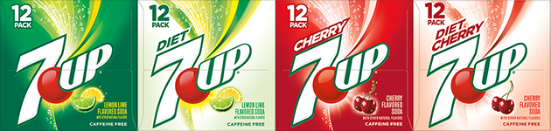
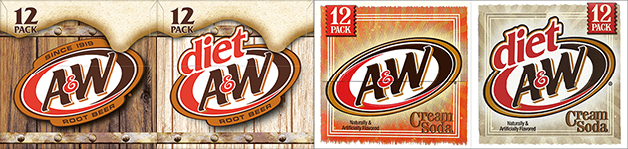
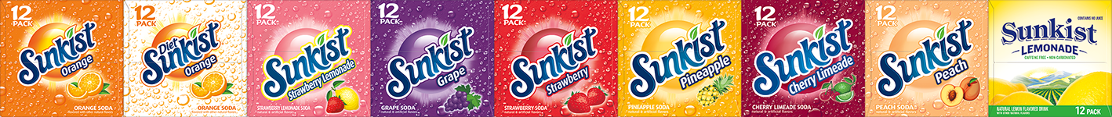
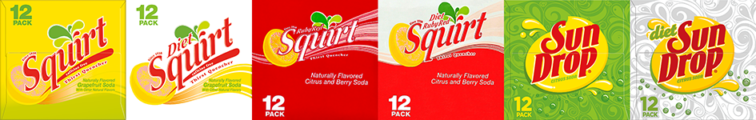
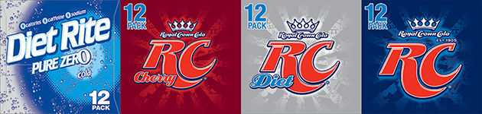
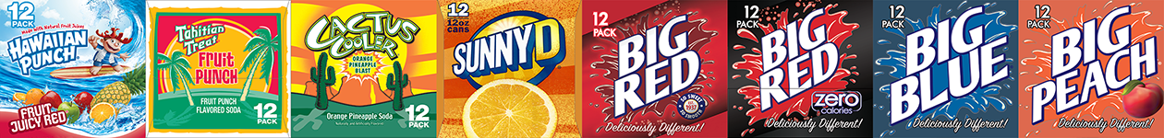
CSD Brand Flow – 7UP Markets
Lemon-Lime
Root Beer
Ale
Citrus
Cola
All Other
Not all brands or packages available for all markets ‐ Questions should be directed to local sales management.

Slide 2
CSD Brand Flow – Dr Pepper Markets
Pepper
Lemon-Lime
Root Beer
Citrus
Ale
Cola
All Other
Not all brands or packages available for all markets ‐ Questions should be directed to local sales management.

Slide 3
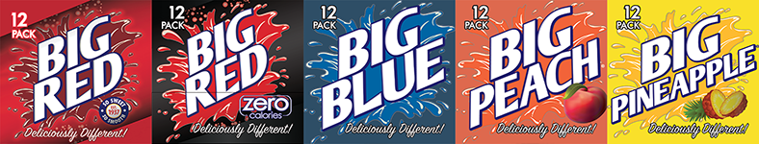
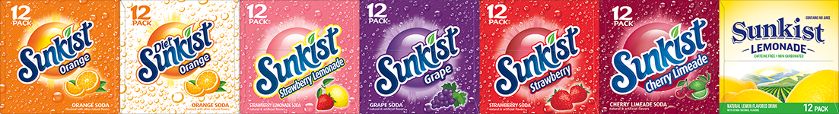
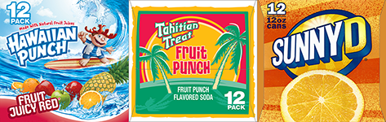
CSD Brand Flow – Big Red Markets South Texas
Big Red
Lemon-Lime
Root Beer
Citrus
Ale
Cola
All Other
Not all brands or packages available for all markets ‐ Questions should be directed to local sales management.

Slide 4
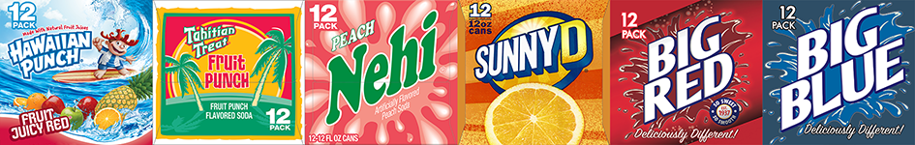
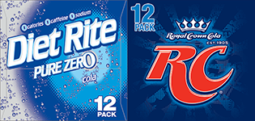
CSD Brand Flow – Southeast Region
Lemon-Lime
Root Beer
Citrus
All Other
Ale
Cola
Not all brands or packages available for all markets ‐ Questions should be directed to local sales management.

