Slide 1

2023 CSD Portfolio

Slide 2

Omaha
13232 Centech Rd.
LaVista, NE 68138
(402) 972-4701
Fax: (402) 895-9121
 | Stacie Jorgensen Manager – Territory Sales Stacie.Jorgensen@kdrp.com (214) 930-3124 |  | Bob Burks Manager – Sales Operations Robert.Burks@kdrp.com (402) 972-4705
Tom Jacobberger Supervisor – District Sales - Omaha Tom.Jacobberger@kdrp.com (402) 505-2300 |  | Brandon Mogensen Supervisor – District Sales - Omaha Brandon.Mogensen@kdrp.com (402) 802-3671 |  | Scott Wiley Supervisor – District Sales - Lincoln Scott.Wiley@kdrp.com (402) 913-6673
Dave Rydl Merchandising Supervisor – Omaha David.Rydl@kdrp.com (402) 505-2226 |  | Rod Schuetz Merchandising Supervisor – Omaha Roderic.Schuetz@kdrp.com (402) 671-3933 |  | Don Peck Merchandising Supervisor - Lincoln Donald.Peck@kdrp.com (402) 968-6729
 |  | Jonathan Grimm Supervisor – District Sales - Norfolk Jonathan.Grimm@kdrp.com (402) 860-1472
 | Dan Boatright Delivery Supervisor – Omaha Dan.Boatright@kdrp.com (402) 490-5977 |  | Tom Schulz Delivery Supervisor – Omaha Tom.Schulz@kdrp.com (402) 807-9248
TO PLACE AN ORDER TelSellPlains_Order1@kdrp.com (800) 862-1904, option #2 |  |  | For equipment service: Plains_EquipmentService@krdp.com (800) 862-1904, option #1
Please include your account number and business name

Slide 3
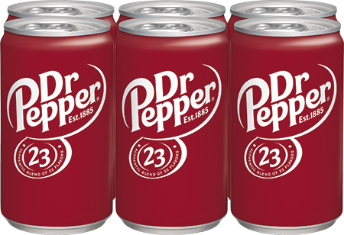
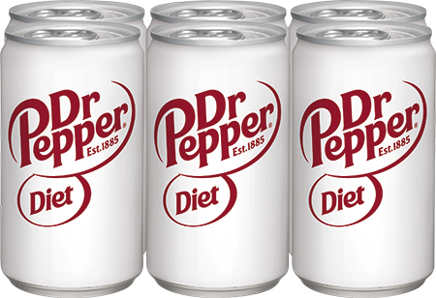
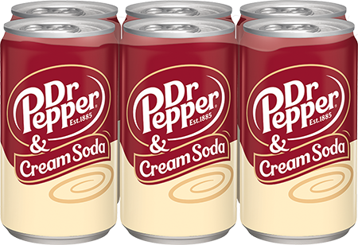
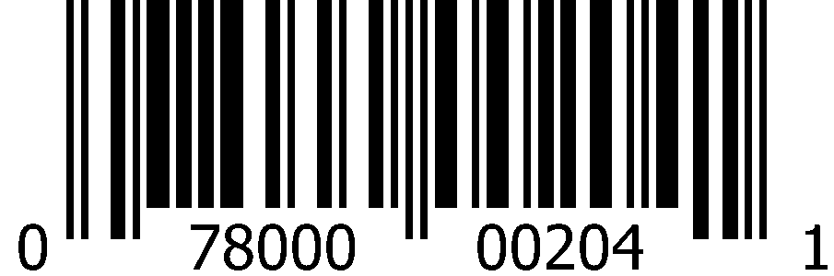
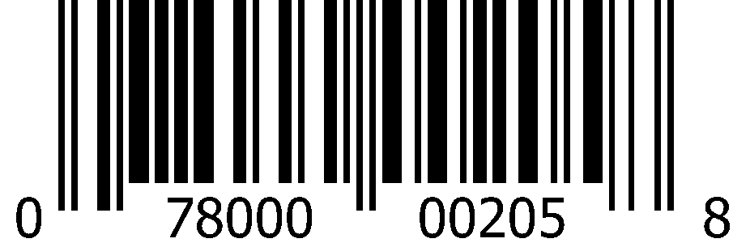
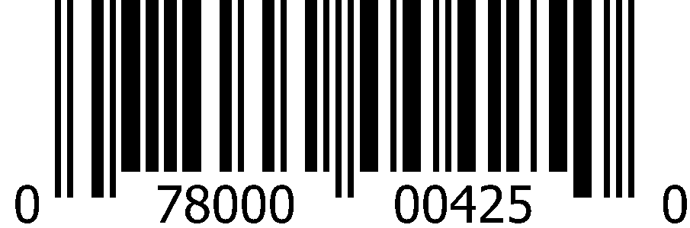
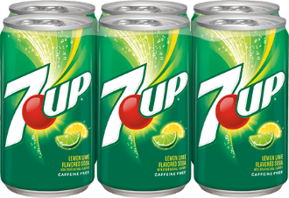
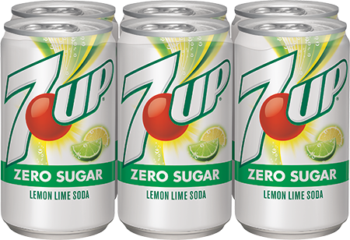
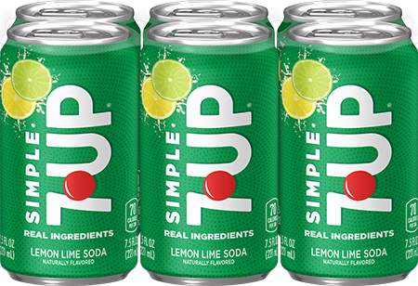
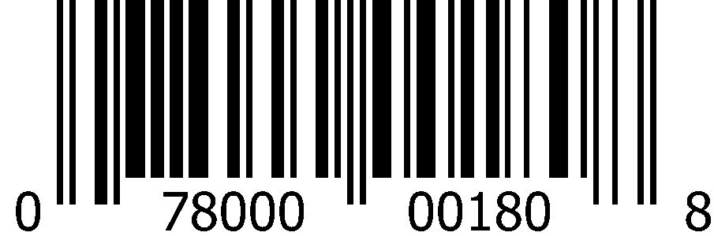
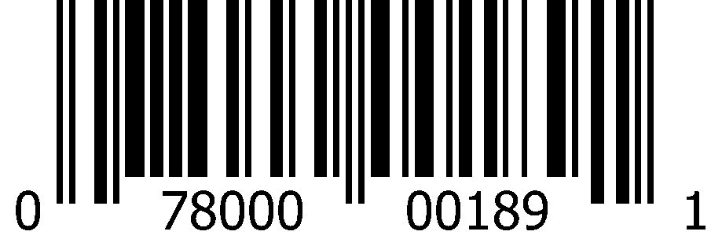
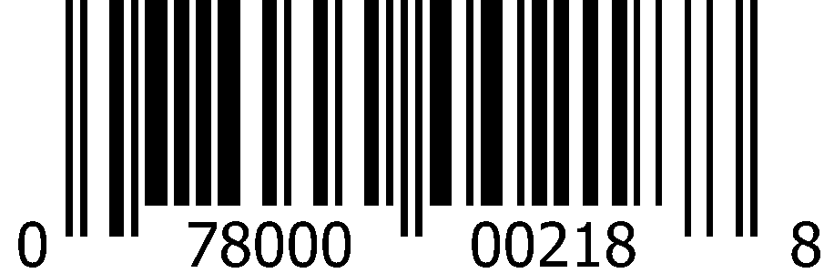
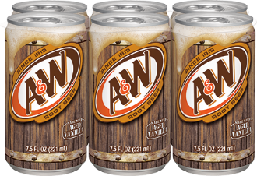
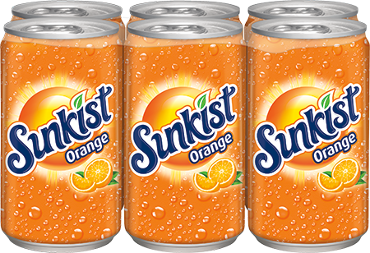
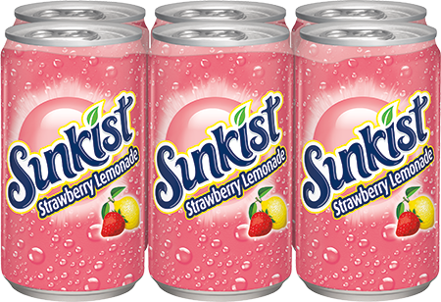
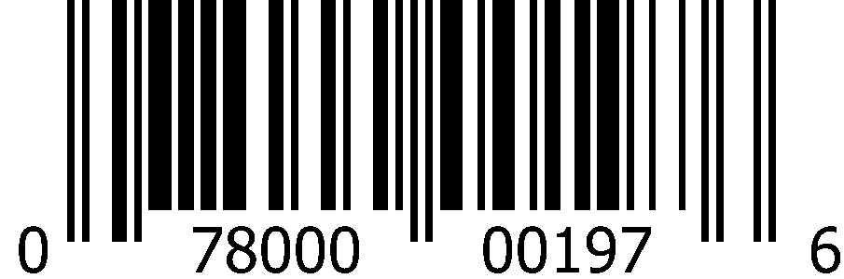
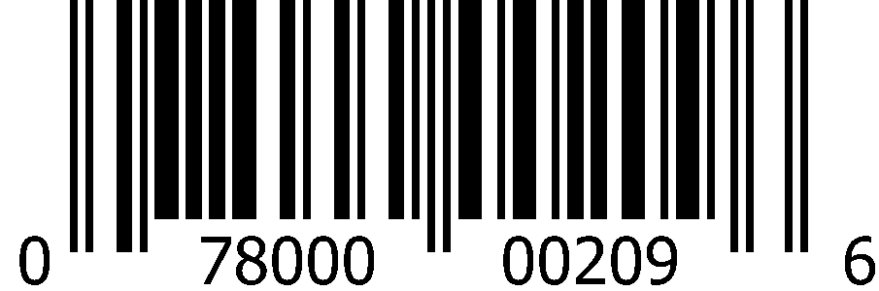
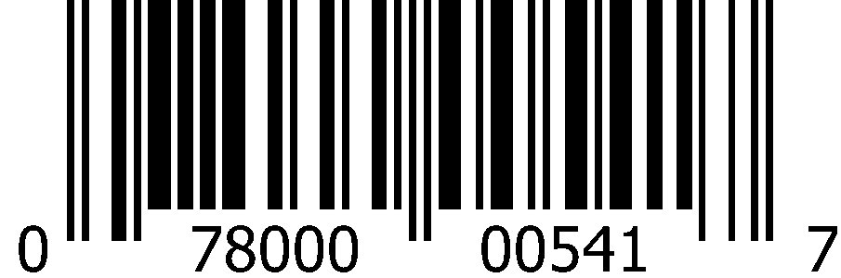
CSD 7.5oz Slim Cans (4x6pk)
 | Dr Pepper |  | Diet Dr Pepper |  | Dr Pepper & Cream Soda
 | 1008 5419 |  | 1008 5420 |  | 1013 7273
 | 0-78000-00204-1 |  | 0-78000-00205-8 |  | 0-78000-00425-0
 | 7Up |  | 7Up Zero Sugar |  | Simple 7Up
 | 1008 5412 |  | 1008 5413 |  | 1013 5076
 | 0-78000-00180-8 |  | 0-78000-00189-1 |  | 0-78000-00218-8
 | A&W Root Beer |  | Sunkist Orange |  | Sunkist Strawberry Lemonade
 | 1008 5415 |  | 1008 5423 |  | 1013 7583
 | 0-78000-00197-6 |  | 0-78000-00209-6 |  | 0-78000-00541-7

Slide 4
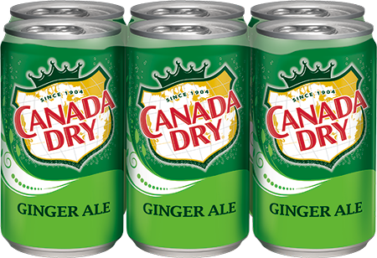
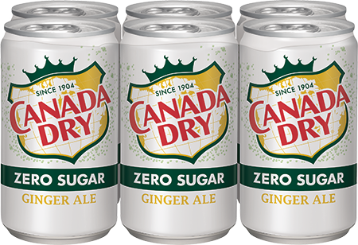
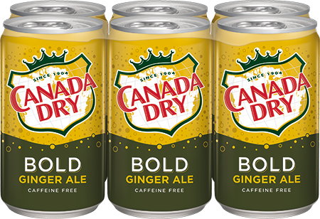

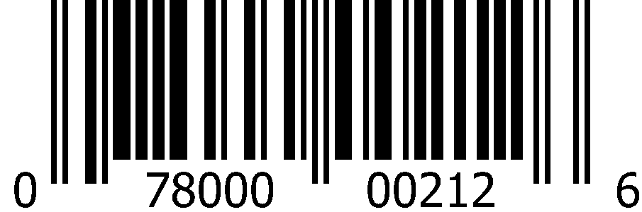
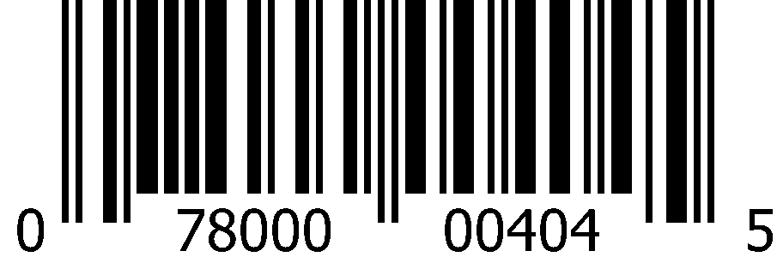
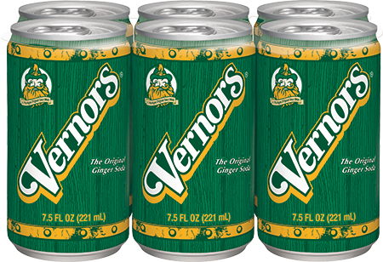
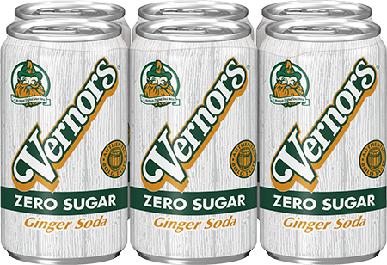
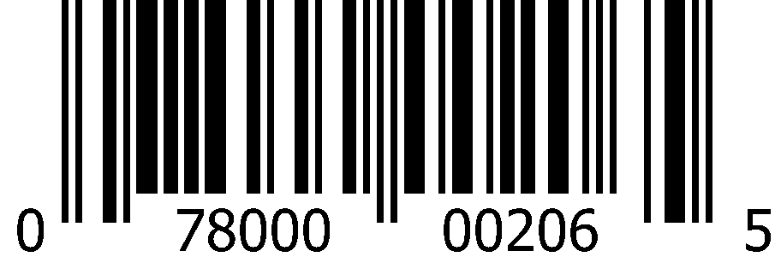
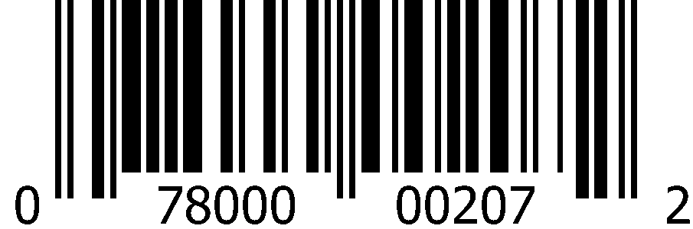
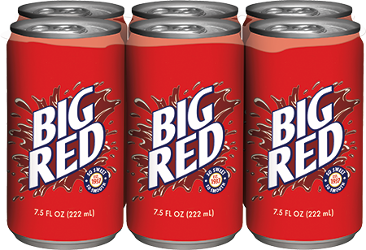
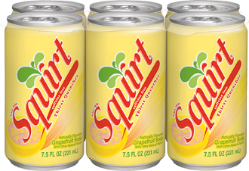
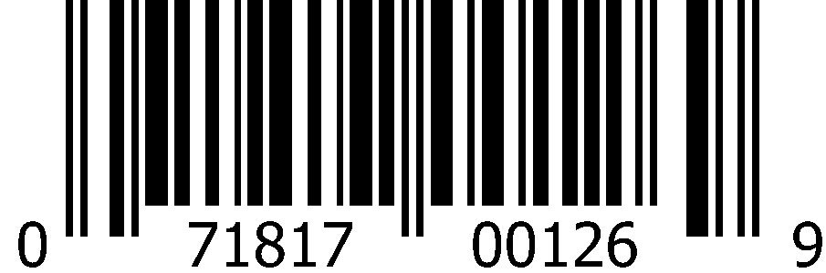

CSD 7.5oz Slim Cans (4x6pk)
 | Canada Dry Ginger Ale |  | Canada Dry Ginger Ale Zero Sugar |  | Canada Dry Bold Ginger Ale
 | 1008 5417 |  | 1008 6588 |  | 1012 6464
 | 0-78000-00201-0 |  | 0-78000-00212-6 |  | 0-78000-00404-5
 | Vernors Ginger Soda |  | Vernors Ginger Soda Zero Sugar
 | 1008 5421 |  | 1008 5422
 | 0-78000-00206-5 |  | 0-78000-00207-2
 | Big Red |  | Squirt
 | 1008 5703 |  | 1008 5424
 | 0-71817-00126-9 |  | 0-78000-00208-9

Slide 5
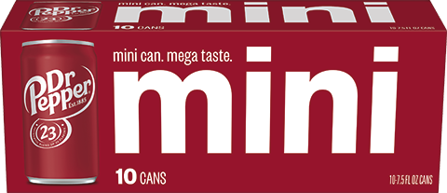
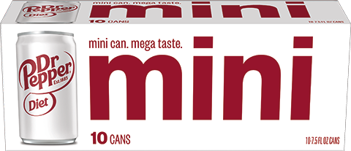
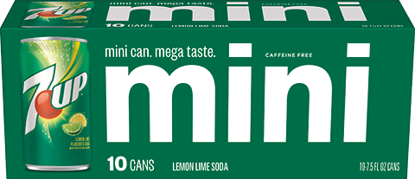
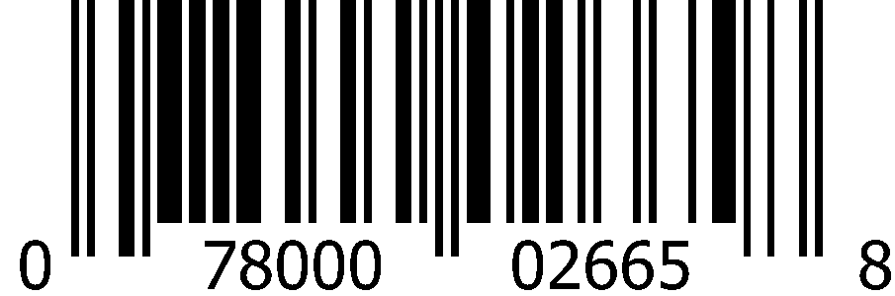
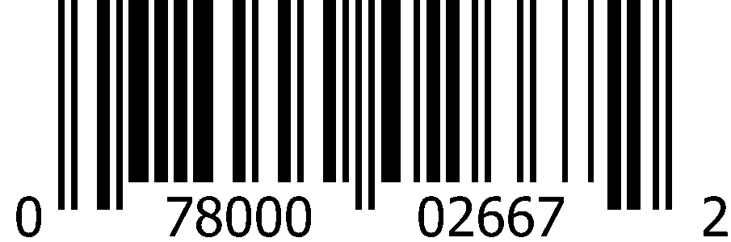
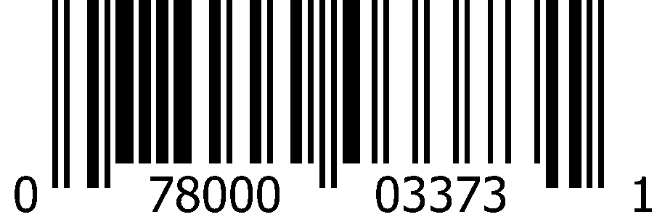
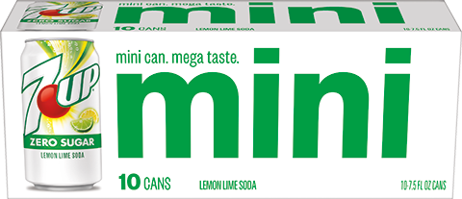
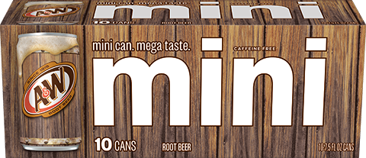
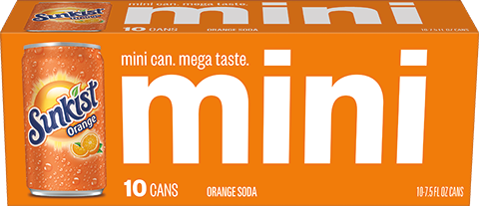
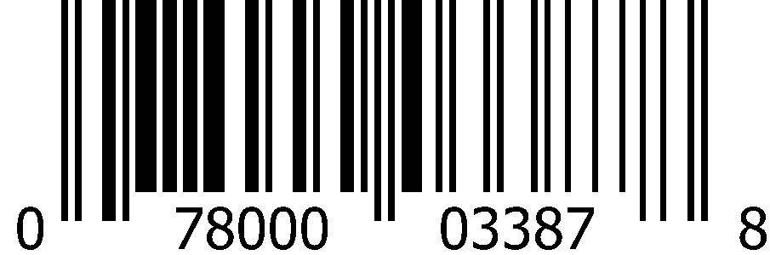
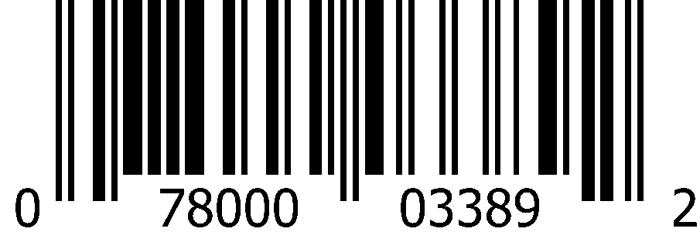
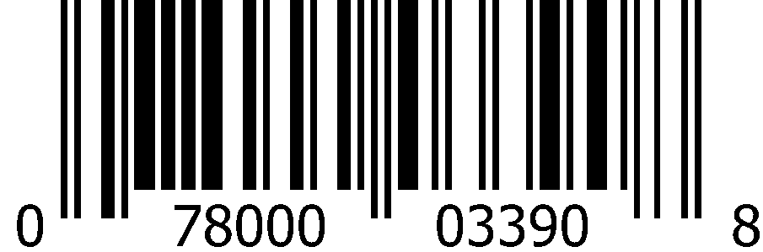
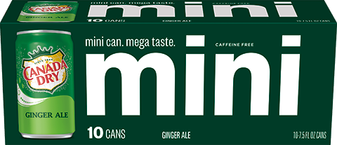
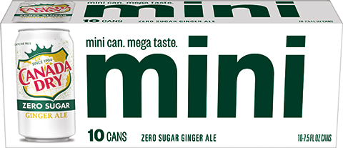
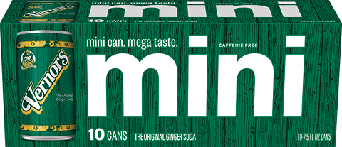
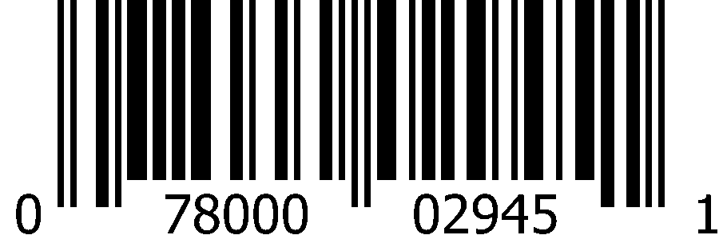

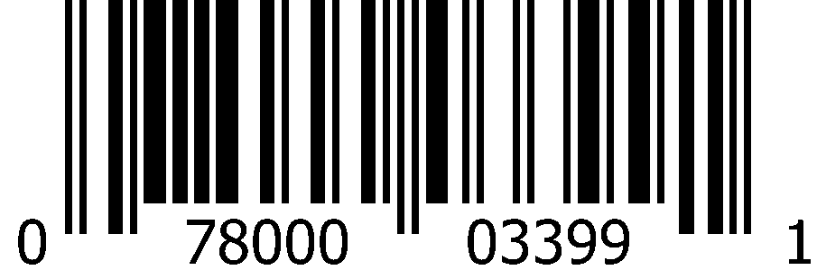
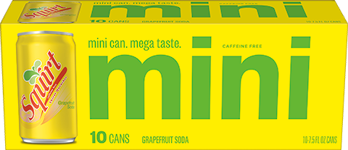
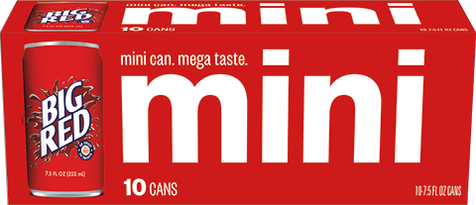
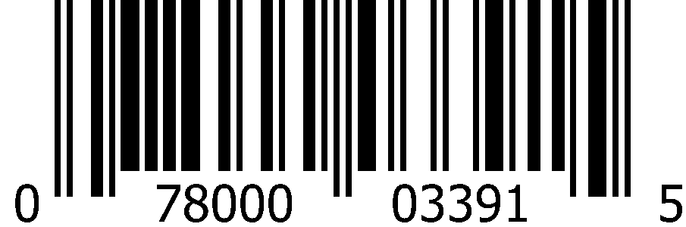

CSD 7.5oz Slim Cans (3x10pk)
 | Dr Pepper |  | Diet Dr Pepper |  | 7Up
 | 1012 8313 |  | 1013 0158 |  | 1012 8315
 | 0-78000-02665-8 |  | 0-78000-02667-2 |  | 0-78000-03373-1
 | 7Up Zero Sugar |  | A&W Root Beer |  | Sunkist Orange
 | 1013 0138 |  | 1013 0141 |  | 1013 0142
 | 0-78000-03387-8 |  | 0-78000-03389-2 |  | 0-78000-03390-8
 | Canada Dry Ginger Ale |  | Canada Dry Ginger Ale Zero Sugar |  | Vernors Ginger Soda
 | 1012 8316 |  | 1013 0140 |  | 1013 0137
 | 0-78000-02945-1 |  | 0-78000-03388-5 |  | 0-78000-03399-1
 | Squirt |  | Big Red
 | 1013 0144 |  | 1013 0139
 | 0-78000-03391-5 |  | 0-71817-41004-7

Slide 6





















CSD 12oz Cans (4x6pk)
 | Dr Pepper |  | Diet Dr Pepper |  | 7Up
 | 1000 1720 |  | 1000 0765 |  | 1000 0759
 | 0-78000-00315-4 |  | 0-78000-00323-9 |  | 0-78000-00038-2
 | A&W Root Beer |  | Sunkist Orange |  | RC Cola
 | 1000 0780 |  | 1000 0790 |  | 1000 0766
 | 0-78000-00187-7 |  | 0-78000-00274-4 |  | 0-78000-00196-9
 | Canada Dry Ginger Ale |  | Canada Dry Club Soda |  | Canada Dry Tonic Water
 | 1000 0809 |  | 1000 0810 |  | 1000 0808
 | 0-78000-00114-3 |  | 0-78000-00122-8 |  | 0-78000-00124-2
 | Vernors Ginger Soda |  | Vernors Ginger Soda Zero Sugar
 | 1000 0814 |  | 1000 0815
 | 0-78000-00939-2 |  | 0-78000-00940-8

Slide 7








CSD 12oz Cans (4x6pk)
 | Dr. Brown's Cream Soda |  | Diet Dr. Brown's Cream Soda
 | 2000 4165 |  | 2000 4169
 | 0-73970-10207-4 |  | 0-73970-00207-7
 | Dr. Brown's Black Cherry |  | Diet Dr. Brown's Black Cherry
 | 2000 4161 |  | 2000 4167
 | 0-73970-10204-3 |  | 0-73970-00204-6

Slide 8
























Carbonated Soft Drinks 12oz Cans (2x12pk)
 | Dr Pepper |  | Diet Dr Pepper |  | Dr Pepper Zero Sugar
 | 1000 0836 Deposit |  | 1000 1754 Deposit |  | 1013 6728
 | 0-78000-08216-6 |  | 0-78000-08316-3 |  | 0-78000-03526-1
 | Dr Pepper & Cream Soda |  | Dr Pepper & Cream Soda Zero Sugar |  | Dr Pepper Strawberries & Cream
 | 1012 7331 |  | 1013 6730 |  | 1015 1598
 | 0-78000-03349-6 |  | 0-78000-03542-1 |  | 0-78000-03761-6
 | Dr Pepper Strawberries & Cream Zero Sugar |  | Cherry Dr Pepper |  | Cherry Dr Pepper Zero Sugar
 | 1015 1599 |  | 1000 1749 |  | 1013 6733
 | 0-78000-03762-3 |  | 0-78000-09816-7 |  | 0-78000-03538-4
 | Caffeine Free Dr Pepper |  | Diet Caffeine Free Dr Pepper |  | Dr Pepper Made with Sugar
 | 1000 0875 |  | 1000 0835 |  | 1000 2778
 | 0-78000-08416-0 |  | 0-78000-08516-7 |  | 0-78000-10216-1

Slide 9










Carbonated Soft Drinks 12oz Cans (2x12pk)
 | 7Up |  | 7Up Zero Sugar |  | Simple 7Up
 | 1000 0829 Deposit |  | 1000 0830 Deposit |  | 1013 5078
 | 0-78000-01180-7 |  | 0-78000-01181-4 |  | 0-78000-03448-6
 | Cherry 7Up |  | Cherry 7Up Zero Sugar
 | 0833 |  | 1000 0834
 | 0-78000-01182-1 |  | 0-78000-01188-3

Slide 10












CSD 12oz Cans (2x12pk)
 | A&W Root Beer |  | A&W Root Beer Zero Sugar
 | 1000 0852 Deposit |  | 1000 0853
 | 0-78000-05216-9 |  | 0-78000-05316-6
 | A&W Cream Soda |  | A&W Cream Soda Zero Sugar
 | 1000 0831 |  | 1000 0832
 | 0-78000-05416-3 |  | 0-78000-05512-2
 | Sun Drop |  | Diet Sun Drop
 | 1000 0874 |  | 1000 0877
 | 0-78000-23016-1 |  | 0-78000-23116-8

Slide 11


















CSD 12oz Cans (2x12pk)
 | Sunkist Orange |  | Sunkist Orange Zero Sugar |  | Sunkist Berry Lemonade
 | 1000 0865 Deposit |  | 1000 0863 |  | 1013 7157
 | 0-78000-11316-7 |  | 0-78000-12216-9 |  | 0-78000-03555-1
 | Sunkist Mango Orange |  | Sunkist Cherry Limeade |  | Sunkist Strawberry Lemonade
 | 1014 2626 |  | 1000 0857 |  | 1012 0690
 | 0-78000-03633-6 |  | 0-78000-12116-2 |  | 0-78000-03176-8
 | Sunkist Watermelon Lemonade |  | Sunkist Grape |  | Sunkist Strawberry
 | 1015 4432 |  | 1000 1699 |  | 1000 1700
 | 0-78000-03772-2 |  | 0-78000-11616-8 |  | 0-78000-11816-2

Slide 12









CSD 12oz Cans (2x12pk)
 | Crush Orange |  | Diet Crush Orange
 | 1002 1944 |  | 1002 1945
 | 0-78000-01305-4 |  | 0-78000-01389-4
 | Crush Grape |  | Crush Strawberry
 | 1002 1904 |  | 1002 1907
 | 0-78000-01345-0 |  | 0-78000-01362-7

Slide 13
















CSD 12oz Cans (2x12pk)
 | Canada Dry Ginger Ale |  | Canada Dry Ginger Ale Zero Sugar |  | Canada Dry Bold Ginger Ale
 | 1000 0904 |  | 1000 0905 |  | 1012 6463
 | 0-78000-15216-6 |  | 0-78000-14816-9 |  | 0-78000-03332-8
 | Canada Dry Ginger Ale and Lemonade |  | Canada Dry Ginger Ale and Lemonade Zero Sugar
 | 1010 5905 |  | 1011 9253
 | 0-78000-03028-0 |  | 0-78000-03239-0
 | Canada Dry Cranberry Ginger Ale |  | Canada Dry Cranberry Ginger Ale Zero Sugar |  | Canada Dry Blackberry Ginger Ale
 | 1000 1994 |  | 1000 3047 |  | 1008 6453
 | 0-78000-15616-4 |  | 0-78000-14116-0 |  | 0-78000-02608-5

Slide 14


















CSD 12oz Cans (2x12pk)
 | Vernors Ginger Soda |  | Vernors Ginger Soda Zero Sugar |  | Schweppes Ginger Ale
 | 1000 0840 |  | 1000 0841 |  | 1000 0856
 | 0-78000-18016-9 |  | 0-78000-18216-3 |  | 0-78000-20616-6
 | Squirt |  | Squirt Zero Sugar |  | Ruby Red Squirt
 | 1000 0187 |  | 1000 0850 |  | 1000 0860
 | 0-78000-01616-1 |  | 0-78000-01716-8 |  | 0-78000-01816-5
 | Hawaiian Punch Fruit Juicy Red |  | Tahitian Treat Fruit Punch |  | Cactus Cooler
 | 1000 0855 |  | 1002 3856 |  | 1001 1970
 | 0-78000-04052-4 |  | 0-78000-02025-0 |  | 0-78000-01162-3

Slide 15














CSD 12oz Cans (2x12pk)
 | Big Red |  | Big Red Zero
 | 1000 0862 |  | 1000 0880
 | 0-71817-03329-1 |  | 0-71817-03330-7
 | Nehi Peach |  | Diet Rite Cola
 | 1000 0180 |  | 1000 0842
 | 0-29500-26295-4 |  | 0-78000-06316-5
 | Cherry RC Cola |  | Diet RC Cola |  | RC Cola
 | 1000 0179 |  | 1000 0839 |  | 1000 0838
 | 0-78000-04416-4 |  | 0-78000-04216-0 |  | 0-78000-04116-3

Slide 16





CSD 12oz Cans (24pk Loose)
 | Canada Dry Ginger Ale |  | Canada Dry Bold Ginger Ale
 | 1000 1068 |  | 1012 6465
 | 0-78000-00114-3 |  | 0-78000-03331-1
 | Canada Dry Club Soda |  | Canada Dry Tonic Water
 | 1000 1069 |  | 1000 1067
 | 0-78000-00122-8 |  | 0-78000-00124-2

Slide 17


















CSD 12oz Cans (24pk)
 | Dr Pepper |  | Dr Pepper Zero Sugar |  | Diet Dr Pepper
 | 1000 1037 |  | 1013 7175 |  | 1000 1038
 | 0-78000-08210-4 |  | 0-78000-03558-2 |  | 0-78000-08310-1
 | Dr Pepper & Cream Soda |  | Dr Pepper Strawberries & Cream |  | A&W Root Beer
 | 1013 3171 |  | 1015 4958 |  | 1000 1044
 | 0-78000-03423-3 |  | 0-78000-03779-1 |  | 0-78000-05210-7
 | 7Up |  | 7Up Zero Sugar |  | Sun Drop
 | 1000 1034 |  | 1000 1035 |  | 1000 1049
 | 0-78000-01214-9 |  | 0-78000-01234-7 |  | 0-78000-23010-9

Slide 18










CSD 12oz Cans (24pk)
 | Sunkist Orange |  | Canada Dry Ginger Ale |  | Squirt
 | 1000 1048 |  | 1000 6264 |  | 1000 1043
 | 0-78000-11310-5 |  | 0-78000-15210-4 |  | 0-78000-01610-9
 | Big Red |  | RC Cola
 | 1000 0219 |  | 1000 1039
 | 0-71817-04329-0 |  | 0-78000-04110-1

Slide 19












CSD 12oz Cans (24pk)
 | Dr Pepper |  | Diet Dr Pepper |  | Dr Pepper Strawberries & Cream
 | 1000 0222 |  | 1000 0223 |  | 1015 4959
 | 0-78000-08213-5 |  | 0-78000-08313-2 |  | 0-78000-03778-4
 | 7Up |  | A&W Root Beer |  | Sunkist Orange
 | 1000 2297 |  | 1000 0227 |  | 1000 0228
 | 0-78000-01105-0 |  | 0-78000-05213-8 |  | 0-78000-11313-6

Slide 20










CSD 12oz Cans (24pk)
 | Canada Dry Ginger Ale |  | Vernors Ginger Soda |  | Squirt
 | 1003 6798 |  | 1000 1719 |  | 1000 0051
 | 0-78000-15213-5 |  | 0-78000-18013-8 |  | 0-78000-01613-0
 | Hawaiian Punch Fruit Juicy Red |  | Big Red
 | 1000 0032 |  | 1000 0226
 | 0-78000-04075-3 |  | 0-78000-04029-9

Slide 21
















CSD 12oz Cans (36pk)
 | Dr Pepper |  | Diet Dr Pepper |  | A&W Root Beer
 | 1000 1615 |  | 1000 1616 |  | 1005 6876
 | 0-78000-80469-0 |  | 0-78000-80470-6 |  | 0-78000-80488-1
 | 7Up |  | Sunkist Orange |  | Canada Dry Ginger Ale
 | 1000 1614 |  | 1000 1617 |  | 1005 6875
 | 0-78000-80486-7 |  | 0-78000-80489-8 |  | 0-78000-80490-4
 | Squirt |  | Big Red
 | 1000 2746 |  | 1009 7659
 | 0-78000-80485-0 |  | 0-71817-04028-2

Slide 22














CSD 16oz Cans (24pk)
 | Dr Pepper |  | A&W Root Beer |  | 7Up
 | 1007 8568 |  | 1008 9269 |  | 1008 9301
 | 0-78000-00586-8 |  | 0-78000-05223-7 |  | 0-78000-00039-9
 | Sunkist Orange |  | Canada Dry Ginger Ale |  | Big Red
 | 1008 6430 |  | 1008 9257 |  | 1009 0161
 | 0-78000-11323-5 |  | 0-78000-02439-5 |  | 0-71817-00132-0
CSD 16oz Cans (12pk)
 | 7Up |  | Canada Dry Ginger Ale |  | Squirt
 | 1008 9301 |  | 1008 9257 |  | 1015 1105
 | 0-78000-00039-9 |  | 0-78000-02439-5 |  | 0-71817-01623-9

Slide 23












CSD 12oz Bellyband Bottles (3x8pk)
 | Dr Pepper |  | Diet Dr Pepper
 | 1000 2278 |  | 1000 2280
 | 0-78000-08231-9 |  | 0-78000-08331-6
 | 7Up |  | 7Up Zero Sugar
 | 1000 2282 |  | 1000 2283
 | 0-78000-01280-4 |  | 0-78000-01281-1
 | A&W Root Beer |  | Sunkist Orange
 | 1000 2281 |  | 1000 2285
 | 0-78000-05288-6 |  | 0-78000-11388-4

Slide 24












CSD 12oz Bellyband Bottles (3x8pk)
 | Canada Dry Ginger Ale |  | Canada Dry Ginger Ale Zero Sugar |  | Vernors Ginger Soda
 | 1004 5978 |  | 1008 3872 |  | 1003 2958
 | 0-78000-15288-3 |  | 0-78000-14888-6 |  | 0-78000-18074-9
 | Vernors Ginger Soda Zero Sugar |  | Squirt |  | Big Red
 | 1003 2959 |  | 1002 8020 |  | 1000 2284
 | 0-78000-18274-3 |  | 0-78000-01688-8 |  | 0-71817-00016-3

Slide 25














CSD 16.9oz Bottles (4x6pk)
 | Dr Pepper |  | Dr Pepper Zero Sugar |  | Diet Dr Pepper
 | 1000 1240 |  | 1013 6727 |  | 1000 1241
 | 0-78000-00386-4 |  | 0-78000-03528-5 |  | 0-78000-00388-8
 | Dr Pepper & Cream Soda |  | Cherry Dr Pepper
 | 1012 7332 |  | 1009 9703
 | 0-78000-03354-0 |  | 0-78000-02590-3
 | 7Up |  | 7Up Zero Sugar
 | 1000 1236 |  | 1000 1237
 | 0-78000-01219-4 |  | 0-78000-01223-1

Slide 26
















CSD 16.9oz Bottles (4x6pk)
 | A&W Root Beer |  | A&W Root Beer Zero Sugar |  | A&W Cream Soda
 | 1000 1251 |  | 1000 1252 |  | 1000 1238
 | 0-78000-05242-8 |  | 0-78000-05342-5 |  | 0-78000-05442-2
 | Sun Drop |  | Diet Sun Drop |  | Crush Orange
 | 1000 1263 |  | 1000 1264 |  | 1002 1949
 | 0-78000-23042-0 |  | 0-78000-23142-7 |  | 0-78000-01325-2
 | Sunkist Orange |  | Sunkist Orange Zero Sugar
 | 1000 1257 |  | 1000 1256
 | 0-78000-11342-6 |  | 0-78000-00676-6

Slide 27














CSD 16.9oz Bottles (4x6pk)
 | Canada Dry Ginger Ale |  | Canada Dry Ginger Ale Zero Sugar |  | Canada Dry Ginger Ale and Lemonade
 | 1000 1266 |  | 1000 2576 |  | 1011 9292
 | 0-78000-00117-4 |  | 0-78000-14842-8 |  | 0-78000-03211-6
 | Vernors Ginger Soda |  | Vernors Ginger Soda Zero Sugar
 | 1000 1243 |  | 1000 1244
 | 0-78000-18042-8 |  | 0-78000-18242-2
 | Squirt |  | Squirt Zero Sugar
 | 1000 1249 |  | 1000 2165
 | 0-78000-00369-7 |  | 0-78000-00377-2

Slide 28








CSD 16.9oz Bottles (4x6pk)
 | Big Red |  | Big Red Zero
 | 1000 1255 |  | 1000 0017
 | 0-71817-00241-9 |  | 0-71817-00243-3
 | Diet Rite Cola |  | RC Cola
 | 1245 |  | 1000 1242
 | 0-78000-06342-4 |  | 0-78000-04142-2

Slide 29






















CSD 20oz Bottles (24pk)
 | Dr Pepper |  | Diet Dr Pepper |  | Dr Pepper Zero Sugar |  | Dr Pepper & Cream Soda
 | 1000 1195 |  | 1000 1625 |  | 1013 6725 |  | 1012 7330
 | 0-78000-08240-1 |  | 0-78000-08340-8 |  | 0-78000-03530-8 |  | 0-78000-03351-9
 | Dr Pepper Strawberries & Cream |  | Cherry Dr Pepper |  | Cherry Dr Pepper Zero Sugar |  | Dr Pepper Made with Sugar
 | 1015 1600 |  | 1000 1796 |  | 1013 6731 |  | 1008 3297
 | 0-78000-03767-8 |  | 0-78000-09840-2 |  | 0-78000-03540-7 |  | 0-78000-80828-5
 | 7Up |  | 7Up Zero Sugar |  | Cherry 7Up
 | 1000 1108 |  | 1000 1091 |  | 1000 1110
 | 0-78000-00161-7 |  | 0-78000-00162-4 |  | 0-78000-00554-7

Slide 30
























CSD 20oz Bottles (24pk)
 | A&W Root Beer |  | A&W Root Beer Zero Sugar |  | A&W Cream Soda |  | Sunkist Orange
 | 1000 1096 |  | 1000 1122 |  | 1000 1109 |  | 1000 1130
 | 0-78000-05240-4 |  | 0-78000-05340-1 |  | 0-78000-05440-8 |  | 0-78000-11340-2
 | Sunkist Orange Zero Sugar |  | Sunkist Strawberry Lemonade |  | Sunkist Berry Lemonade |  | Sunkist Cherry Limeade
 | 1000 1129 |  | 1012 0687 |  | 1013 6557 |  | 1000 1125
 | 0-78000-12240-4 |  | 0-78000-03178-2 |  | 0-78000-03520-9 |  | 0-78000-12140-7
 | Sunkist Mango Orange |  | Sunkist Grape |  | Sunkist Strawberry |  | Sunkist Pineapple
 | 1014 2627 |  | 1000 1704 |  | 1000 1705 |  | 1000 0045
 | 0-78000-03636-7 |  | 0-78000-11640-3 |  | 0-78000-11840-7 |  | 0-78000-12440-8

Slide 31




















CSD 20oz Bottles (24pk)
 | Crush Orange |  | Crush Strawberry |  | Crush Grape |  | Crush Cherry
 | 1002 1990 |  | 1002 1993 |  | 1002 1992 |  | 1002 1991
 | 0-78000-01328-3 |  | 0-78000-01369-6 |  | 0-78000-01352-8 |  | 0-78000-01382-5
 | Sun Drop |  | Diet Sun Drop |  | Nehi Peach
 | 1000 1751 |  | 1000 1134 |  | 1000 0041
 | 0-78000-23040-6 |  | 0-78000-23140-3 |  | 0-29500-26762-1
 | Hawaiian Punch Fruit Juicy Red |  | Tahitian Treat Fruit Punch |  | Cactus Cooler
 | 1000 1123 |  | 1002 7683 |  | 1001 1968
 | 0-78000-00402-1 |  | 0-78000-02040-3 |  | 0-78000-01164-7

Slide 32






















CSD 20oz Bottles (24pk)
 | Canada Dry Ginger Ale |  | Canada Dry Ginger Ale Zero Sugar |  | Canada Dry Ginger Ale and Lemonade |  | Canada Dry Cranberry Ginger Ale
 | 1000 1150 |  | 1005 7516 |  | 1010 5909 |  | 1007 9297
 | 0-78000-15240-1 |  | 0-78000-14840-4 |  | 0-78000-03024-2 |  | 0-78000-15640-9
 | Canada Dry Black Cherry Wishniak |  | Canada Dry Peach |  | Canada Dry Pineapple |  | Canada Dry Vanilla Cream
 | 1007 9300 |  | 1013 4937 |  | 1007 9298 |  | 1007 9291
 | 0-78000-16040-6 |  | 0-78000-16440-4 |  | 0-78000-14440-6 |  | 0-78000-15840-3
 | Canada Dry Green Tea Ginger Ale |  |  |  | Vernors Ginger Soda |  | Vernors Ginger Soda Zero Sugar
 | 1000 1143 |  |  |  | 1000 1112 |  | 1000 1113
 | 0-78000-16840-2 |  |  |  | 0-78000-18040-4 |  | 0-78000-18240-8

Slide 33


















CSD 20oz Bottles (24pk)
 | Squirt |  | Squirt Zero Sugar |  | Ruby Red Squirt
 | 1000 1120 |  | 1000 1121 |  | 1000 1127
 | 0-78000-01640-6 |  | 0-78000-01740-3 |  | 0-78000-01840-0
 | Big Red |  | Big Red Zero |  | Big Blue
 | 1000 1128 |  | 1000 1100 |  | 1000 0042
 | 0-71817-00037-8 |  | 0-71817-00038-5 |  | 0-71817-00039-2
 | Big Peach |  | Big Pineapple |  | RC Cola
 | 1000 1136 |  | 1000 1142 |  | 1000 1111
 | 0-71817-00092-7 |  | 0-71817-00082-8 |  | 0-78000-04140-8

Slide 34
















CSD 20oz 99￠Pre-Priced Bottles (24pk)
 | Sunkist Orange
 | 1000 1894
 | 0-78000-05072-1
 | Sunkist Strawberry Lemonade |  | Sunkist Berry Lemonade |  | Sunkist Cherry Limeade |  | Sunkist Mango Orange
 | 1013 3175 |  | 1013 6484 |  | 1013 5621 |  | 1014 2628
 | 0-78000-03424-0 |  | 0-78000-03522-3 |  | 0-78000-03488-2 |  | 0-78000-03638-1
 | Sunkist Grape |  | Sunkist Strawberry |  | Sunkist Pineapple
 | 1002 2241 |  | 1002 2242 |  | 1003 6212
 | 0-78000-01676-5 |  | 0-78000-01677-2 |  | 0-78000-02065-6

Slide 35










CSD 20oz 99￠Pre-Priced Bottles (24pk)
 | Big Red |  | Big Blue
 | 1002 9260 |  | 1000 3275
 | 0-71817-79937-1 |  | 0-71817-80000-8
 | RC Cola |  | Tahitian Treat Fruit Punch |  | Cactus Cooler
 | 1002 9261 |  | 1002 3919 |  | 1001 1971
 | 0-78000-06050-8 |  | 0-78000-02038-0 |  | 0-78000-01165-4

Slide 36
























CSD 1 Liter Bottles (15pk)
 | Dr Pepper |  | Diet Dr Pepper |  | A&W Root Beer |  | 7Up
 | 1000 1317 |  | 1000 1318 |  | 1000 1323 |  | 1000 1315
 | 0-78000-08245-6 |  | 0-78000-08345-3 |  | 0-78000-05245-9 |  | 0-78000-00028-3
 | Sunkist Orange |  | Squirt |  | Hawaiian Punch Fruit Juicy Red |  | Big Red
 | 1000 1332 |  | 1000 1322 |  | 1000 1325 |  | 1000 0069
 | 0-78000-11345-7 |  | 0-78000-01645-1 |  | 0-78000-00407-6 |  | 0-71817-00045-3
 | RC Cola |  | Vernors Ginger Soda |  | Canada Dry Ginger Ale |  | Canada Dry Ginger Ale Zero Sugar
 | 1000 1319 |  | 1000 0384 |  | 1000 1335 |  | 1000 4677
 | 0-78000-00319-2 |  | 0-78000-18045-9 |  | 0-78000-15245-6 |  | 0-78000-14845-9

Slide 37








CSD 1.25 Liter Bottles (12pk)
 | A&W Root Beer |  | 7Up
 | 1010 7490 |  | 1010 7491
 | 0-78000-02657-3 |  | 0-78000-02659-7
 | Canada Dry Ginger Ale |  | Sunkist Orange
 | 1010 7539 |  | 1010 7564
 | 0-78000-01154-6 |  | 0-78000-02598-9

Slide 38














CSD 2 Liter Bottles (8pk)
 | Dr Pepper |  | Dr Pepper Zero Sugar |  | Diet Dr Pepper
 | 1000 1422 |  | 1013 6726 |  | 1000 1423
 | 0-78000-08246-3 |  | 0-78000-03532-2 |  | 0-78000-08346-0
 | Dr Pepper & Cream Soda |  | Cherry Dr Pepper |  | Cherry Dr Pepper Zero Sugar
 | 1013 7258 |  | 1000 1798 |  | 1013 6732
 | 0-78000-03552-0 |  | 0-78000-09846-4 |  | 0-78000-03536-0
 | Dr Pepper Made with Sugar
 | 1008 9255
 | 0-78000-10246-8

Slide 39




















CSD 2 Liter Bottles (8pk)
 | 7Up |  | 7Up Zero Sugar |  | Cherry 7Up |  | Cherry 7Up Zero Sugar
 | 1000 1415 |  | 1000 1416 |  | 1000 1419 |  | 1000 1420
 | 0-78000-00034-4 |  | 0-78000-00075-7 |  | 0-78000-00531-8 |  | 0-78000-00831-9
 | A&W Root Beer |  | A&W Root Beer Zero Sugar |  | A&W Cream Soda |  | A&W Cream Soda Zero Sugar
 | 1000 1437 |  | 1000 1438 |  | 1000 1417 |  | 1000 0095
 | 0-78000-05246-6 |  | 0-78000-05346-3 |  | 0-78000-05446-0 |  | 0-78000-05546-7
 | Sun Drop |  | Diet Sun Drop
 | 1000 1467 |  | 1000 1468
 | 0-78000-23046-8 |  | 0-78000-23146-5

Slide 40






















CSD 2 Liter Bottles (8pk)
 | Sunkist Orange |  | Sunkist Orange Zero Sugar |  | Sunkist Strawberry Lemonade |  | Sunkist Berry Lemonade
 | 1000 1455 |  | 1000 1454 |  | 1012 0686 |  | 1013 7158
 | 0-78000-11346-4 |  | 0-78000-12246-6 |  | 0-78000-03180-5 |  | 0-78000-03554-4
 | Sunkist Cherry Limeade |  | Sunkist Grape |  | Sunkist Strawberry
 | 1000 0097 |  | 1000 1712 |  | 1000 1713
 | 0-78000-12146-9 |  | 0-78000-11646-5 |  | 0-78000-11846-9
 | Crush Orange |  | Diet Crush Orange |  | Crush Grape |  | Crush Strawberry
 | 1002 1981 |  | 1002 1980 |  | 1002 1983 |  | 1002 1984
 | 0-78000-01336-8 |  | 0-78000-01397-9 |  | 0-78000-01356-6 |  | 0-78000-01371-9

Slide 41




















CSD 2 Liter Bottles (8pk)
 | Canada Dry Ginger Ale |  | Canada Dry Ginger Ale Zero Sugar |  | Canada Dry Bold Ginger Ale
 | 1000 1487 |  | 1000 1488 |  | 1012 6466
 | 0-78000-15246-3 |  | 0-78000-14846-6 |  | 0-78000-03328-1
 | Canada Dry Ginger Ale and Lemonade |  | Canada Dry Cranberry Ginger Ale |  | Canada Dry Cranberry Ginger Ale Zero Sugar |  | Canada Dry Blackberry Ginger Ale
 | 1010 5906 |  | 1000 1595 |  | 1000 1596 |  | 1008 1257
 | 0-78000-03025-9 |  | 0-78000-15646-1 |  | 0-78000-14146-7 |  | 0-78000-02505-7
 | Vernors Ginger Soda |  | Vernors Ginger Soda Zero Sugar |  | Schweppes Ginger Ale
 | 1000 0098 |  | 1000 1535 |  | 1000 1442
 | 0-78000-18046-6 |  | 0-78000-18246-0 |  | 0-78000-20646-3

Slide 42












CSD 2 Liter Bottles (8pk)
 | Squirt |  | Squirt Zero Sugar |  | Ruby Red Squirt
 | 1000 1435 |  | 1000 1436 |  | 1000 0096
 | 0-78000-01646-8 |  | 0-78000-01746-5 |  | 0-78000-01846-2
 | Hawaiian Punch Fruit Juicy Red |  | Tahitian Treat Fruit Punch |  | Cactus Cooler
 | 1000 1440 |  | 1002 3918 |  | 1001 1973
 | 0-78000-00408-3 |  | 0-78000-02036-6 |  | 0-78000-01169-2

Slide 43












CSD 2 Liter Bottles (8pk)
 | Big Red |  | Big Red Zero |  | Big Blue
 | 1000 1453 |  | 1000 1470 |  | 1000 2245
 | 0-71817-00021-7 |  | 0-71817-00031-6 |  | 0-71817-00071-2
 | Nehi Peach |  | Diet Rite Cola |  | RC Cola
 | 1000 1471 |  | 1426 |  | 1000 1424
 | 0-29500-26932-8 |  | 0-78000-06346-2 |  | 0-78000-00337-6

Slide 44




















CSD 2 Liter $1.29 Pre-Priced Bottles (8pk)
 | Sunkist Orange |  | Sunkist Berry Lemonade |  | Sunkist Strawberry Lemonade |  | Sunkist Cherry Limeade
 | 1012 0772 |  | 1015 6188 |  | 1015 6193 |  | 1015 6192
 | 0-78000-03290-1 |  | 0-78000-03804-0 |  | 0-78000-03806-4 |  | 0-78000-03805-7
 | Sunkist Strawberry |  | Sunkist Pineapple |  | Sunkist Peach
 | 1012 0767 |  | 1012 0766 |  | 1012 0769
 | 0-78000-03292-5 |  | 0-78000-03293-2 |  | 0-78000-03294-9
 | Tahitian Treat Fruit Punch |  | Cherry RC Cola |  | RC Cola
 | 1012 0768 |  | 1012 0765 |  | 1012 0764
 | 0-78000-03289-5 |  | 0-78000-03288-8 |  | 0-78000-03287-1

Slide 45










CSD 2 Liter Bottles (6pk)
 | Dr. Brown's Cream Soda |  | Diet Dr. Brown's Cream Soda |  | Dr. Brown's Root Beer
 | 2000 6833 |  | 2000 6834 |  | 2000 6835
 | 0-73970-31107-0 |  | 0-73970-31207-7 |  | 0-73970-31111-7
 | Dr. Brown's Black Cherry |  | Diet Dr. Brown's Black Cherry
 | 2000 6831 |  | 2000 6832
 | 0-73970-31104-9 |  | 0-73970-31204-6

Slide 46














CSD Premium Glass Bottles
 | 8oz Real Sugar Dr Pepper (4x6pk) |  | 7Up (12pk) 355mL Mexican Glass |  | Squirt (12pk) 355mL Mexican Glass
 | 1003 0587 |  | 2002 6451 |  | 2002 6453
 | 0-78000-00335-2 |  | 0-78000-01954-4 |  | 0-78000-01952-0
12oz Glass Bottles (6x4pk)
 | Real Sugar Dr Pepper
 | 1008 1780
 | 0-78000-08294-4
 | Crush Orange |  | Crush Grape |  | Crush Strawberry
 | 1008 7177 |  | 1008 7178 |  | 1008 7179
 | 0-78000-02756-3 |  | 0-78000-02757-0 |  | 0-78000-02758-7

Slide 47
























CSD 12oz Glass Bottles (24pk)
 | Dr Pepper |  | Real Sugar Dr Pepper |  | 7Up |  | A&W Root Beer
 | 1000 0005 |  | 1008 5268 |  | 1000 0007 |  | 1000 0011
 | 0-78000-08256-2 |  | 0-78000-80987-9 |  | 0-78000-00007-8 |  | 0-78000-00258-4
 | Sun Drop |  | Sunkist Orange |  | Big Red |  | Real Sugar Big Red
 | 1000 1389 |  | 1000 0012 |  | 1000 0009 |  | 1012 0971
 | 0-78000-00649-0 |  | 0-78000-11383-9 |  | 0-71817-00012-5 |  | 0-71817-79999-9
 | Nehi Peach |  | Nehi Grape |  | Nehi Orange |  | RC Cola
 | 1000 1390 |  | 1000 2242 |  | 1000 2243 |  | 1000 0008
 | 0-29500-26252-7 |  | 0-29500-21252-2 |  | 0-29500-20252-3 |  | 0-78000-00198-3

Slide 48





















Stewart’s Fountain Classics 12oz Glass Bottles
 | Root Beer |  | Diet Root Beer |  | Orange ‘n Cream
 | 1008 7165 |  | 1000 0360 |  | 1008 7163
 | 0-98794-00026-9 |  | 0-98794-50500-9 |  | 0-98794-00027-6
 | Diet Orange ‘n Cream |  | Cream Soda |  | Black Cherry Wishniak
 | 1000 0368 |  | 1008 7164 |  | 1008 7166
 | 0-98794-80500-0 |  | 0-98794-00028-3 |  | 0-98794-00029-0
 | Key Lime |  | Cherries ‘n Cream |  | Birch Beer |  | Grape Soda
 | 1008 7169 |  | 1008 7167 |  | 1008 7170 |  | 1008 7168
 | 0-98794-00030-6 |  | 0-98794-00031-3 |  | 0-98794-00033-7 |  | 0-98794-00032-0

Slide 49




















Stewart’s Fountain Classics 12oz Glass Bottles (6x4pk)
 | Root Beer |  | Diet Root Beer |  | Orange ‘n Cream
 | 1008 7165 |  | 1000 0360 |  | 1008 7163
 | 0-98794-00018-4 |  | 0-98794-51504-6 |  | 0-98794-00019-1
 | Diet Orange ‘n Cream |  | Cream Soda |  | Black Cherry Wishniak
 | 1000 0368 |  | 1008 7164 |  | 1008 7166
 | 0-98794-81804-8 |  | 0-98794-00020-7 |  | 0-98794-00021-4
 | Key Lime |  | Cherries ‘n Cream |  | Birch Beer |  | Grape Soda
 | 1008 7169 |  | 1008 7167 |  | 1008 7170 |  | 1008 7168
 | 0-98794-00022-1 |  | 0-98794-00023-8 |  | 0-98794-00025-2 |  | 0-98794-00024-5

Slide 50














CSD Bag-In-A-Box Fountain Syrup (5 gallon)
 | Dr Pepper |  | Diet Dr Pepper |  | 7Up
 | 1000 0703 |  | 1000 0704 |  | 1000 0701
 | 0-54900-71054-5 |  | 0-54900-72047-6 |  | 0-78000-20001-0
 | IBC Root Beer |  | Rochester Root Beer |  | Sunkist Orange
 | 1000 0304 |  | 1000 0315 |  | 1000 00715
 | 0-88500-90183-6 |  | 0-88500-90319-9 |  | 0-88500-90111-9
 | Vernors Ginger Soda |  | Squirt
 | 1000 0706 |  | 1000 0708
 | 0-88500-90169-0 |  | 0-88500-90137-9

Slide 51












CSD Bag-In-A-Box Fountain Syrup (5 gallon)
 | Hawaiian Punch Fruit Juicy Red |  | Hawaiian Punch Lemonade |  | Big Red |  | Diet RC Cola
 | 1000 0306 |  | 1008 8185 |  | 1000 0714 |  | 1000 0299
 | 0-88500-90280-2 |  | 0-88500-00120-8 |  | 0-71817-00055-2 |  | 0-88500-90229-1
 | RC Cola |  | Sun Plus Raspberry Seltzer |  | Nature Tree Premium Tea |  | Nature Tree Raspberry
 | 1000 0705 |  | 2000 0046 |  | 2000 0468 |  | 2000 0467
 | 0-88500-90226-0 |  | 8-34093-00559-4 |  | 8-34093-00976-9 |  | 8-34093-00977-6
 | Dr Pepper (Scholle) |  |  | Dr Pepper (FCB)
 | 1000 0319 |  |  | 1001 0404
 | 0-54900-71054-5 |  |  | 0-54900-80005-5

Slide 52












CSD Bag-In-A-Box Fountain Syrup (3 gallon)
Magic Mixer Sweet & Sour |  | Magic Mixer Margarita |  | Magic Mixer Bloody Mary |  | Nature Tree Premium Tea
2000 0503 |  | 2000 0505 |  | 2000 0500 |  | 2000 0522
8-34093-00961-5 |  | 8-34093-31039-1 |  | 8-34093-00980-6 |  | 1-23456-78912-8
Cranberry |  | 50% Orange |  | Tonic Water |  | Pineapple
2000 0509 |  | 2000 0499 |  | 2000 0515 |  | 2000 0508
8-34093-00971-4 |  | 8-34093-00991-2 |  | 8-34093-00870-0 |  | 8-34093-00994-3
100% Orange |  | Energy BIB |  | Magic Mixer Bloody Mary (2 Gallon) |  | Grapefruit (2 Gallon)
2000 0498 |  | 2000 0516 |  | 2002 7930 |  | 2000 0538
8-34093-00965-3 |  | 0-00000-00000-0 |  | 8-34093-00000-1 |  | 8-34093-00987-5

Slide 53



















CSD Bag-In-A-Box Fountain Syrup (2.5 gallon)
 | Dr Pepper |  | Diet Dr Pepper |  | 7Up |  | Diet 7Up
 | 1000 0320 |  | 1000 1622 |  | 1000 0321 |  | 1000 0322
 | 0-54900-71056-9 |  | 0-54900-72049-0 |  | 0-78000-20011-9 |  | 0-78000-30005-5
 | IBC Root Beer |  | Sun Drop |  | Sunkist Orange |  | Sunkist Grape
 | 1000 1732 |  | 1001 2014 |  | 1000 00327 |  | 1007 8957
 | 0-88500-90224-6 |  | 0-88500-90172-0 |  | 0-88500-90119-5 |  | 0-88500-00108-6
 | Sunkist Strawberry |  | Sunkist Cherry Limeade |  | Canada Dry Ginger Ale |  | Canada Dry Tonic Water
 | 1007 8956 |  | 1000 00328 |  | 1006 6318 |  | 1000 0330
 | 0-88500-00109-3 |  | 0-88500-90204-8 |  | 0-78000-90125-6 |  | 0-88500-90177-5

Slide 54













CSD Bag-In-A-Box Fountain Syrup (2.5 gallon)
 | Squirt |  | Hawaiian Punch Fruit Juicy Red |  | Hawaiian Punch Lemonade |  | Hawaiian Punch Pink Lemonade
 | 1000 0232 |  | 1000 0329 |  | 1008 8270 |  | 1008 8970
 | 0-88500-90171-3 |  | 0-88500-90277-2 |  | 0-88500-00118-5 |  | 0-88500-00121-5
 | Big Red |  | Diet Rite Cola |  | Diet RC Cola |  | RC Cola
 | 1000 0324 |  | 1000 0260 |  | 1000 0323 |  | 1000 0261
 | 0-71817-00255-6 |  | 0-88500-90246-8 |  | 0-88500-90228-4 |  | 0-88500-90248-2
 | Dr Pepper (FCB) |  | Sunkist Cherry Limeade (FCB) |  | Hawaiian Punch Fruit Juicy Red (FCB) |  | Big Red (FCB)
 | 1000 0331 |  | 1000 0333 |  | 1001 0403 |  | 1000 0332
 | 0-54900-01053-9 |  | 0-88500-90206-2 |  | 0-88500-90321-2 |  | 0-71817-00265-5

Slide 55







2023 KDP Cold Beverage
CSD Portfolio
©2023 GRI Multi Media
Design, layout and content creation by Jonathan Grimm
Jonathan.Grimm@kdrp.com

