Slide 1


2024 Plains Region Portfolio

Slide 2


Sioux Falls
714 N Helen Ave
Sioux Falls, SD 57104
Sioux City
2800 Expedition Ct
Sioux City, IA 51111
 |  | Stacie Jorgensen Manager – Territory Sales Stacie.Jorgensen@kdrp.com (214) 930-3124 |  |  | Bob Burks Manager – Sales Operations Robert.Burks@kdrp.com (402) 972-4705
 | Robert Williams Supervisor – District Sales – Sioux Falls Robert.Williams1@kdrp.com (712) 363-5705 |  | Don Peck Supervisor – District Sales - Omaha Donald.Peck@kdrp.com (402) 968-6729 |  |  | William Hedrick Supervisor – District Sales – Sioux City William.Hedrick@kdrp.com (712) 363-9751
Christopher Kleckner Account Sales Manager – Sioux Falls Christopher.Kleckner@kdrp.com (605) 376-7949 |  |  | Steven Olson Account Sales Manager – Sioux Falls Steven.Olson@kdrp.com (712) 301-4491 |  |  | Brandon Smith Account Sales Manager – Sioux City Brandon.Smith2@kdrp.com (712) 577-3539
Steven Randolph Account Sales Manager – Sioux Falls Steven.Randolph@kdrp.com (712) 281-8424 |  |  | Steven Sowell Relief Account Manager – Siouxland Steven.Sowell@kdrp.com (605) 370-7901 |  |  | Keegan Lamoureux Account Sales Manager – Sioux City Keegan.Lamoureux@kdrp.com (605) 231-1320
Dusty Stultz Merchandiser Supervisor - Siouxland Charles.Stultz@kdrp.com (712) 635-8973 |  |  |  |  |  | Christopher Sitzmann Distribution Supervisor - Siouxland Christopher.Sitzmann@kdrp.com (712) 281-8564
TO PLACE AN ORDER TelSellPlains_Order1@kdrp.com (800) 862-1904, option #2 |  |  |  |  | For equipment service: Plains_EquipmentService@kdrp.com (800) 862-1904, option #1
Please include your account number and business name

Slide 3
Table of Contents
CSD 7.5oz Slim Cans (4x6pk)..................................4
CSD 7.5oz Slim Cans (3x10pk)................................5
CSD 12oz Cans (2x12pk)....................................6-10
CSD 12oz Cans (18pk)............................................11
CSD 12oz Cans (24pk)............................................12
CSD 16oz Cans (24pk)............................................13
CSD 12oz Bellyband Bottles (3x8pk)....................14
CSD 16.9oz Bottles (4x6pk)..............................15-16
CSD 20oz Bottles (24pk)...................................17-19
CSD 1 Liter Bottles (15pk).....................................20
CSD 1.25 Liter Bottles (15pk)................................21
CSD 2 Liter Bottles (8pk)..................................22-24
CSD 2 Liter $1.49 Pre-Priced Bottles (8pk)..........25
355mL Mexican Glass (12pk).................................26
Stewart’s 12oz Glass Bottles (6x4pk)...................27
CSD BIB Fountain Syrup (2.5 gallon)...................28
Canada Dry Mixers Bottles....................................29
Canada Dry Mixers 7.5oz Cans (4x6pk)................30
Polar Sparkling Seltzer.....................................31-35
CORE Hydration+...................................................36
Bai.......................................................................37-39
Snapple Elements...................................................40
Snapple..............................................................41-47
Yoo-hoo...................................................................48
Clamato...................................................................48
La Colombe........................................................49-50
Electrolit.............................................................51-52
C4 Energy...........................................................53-57
A Shoc.....................................................................58
A Shoc Accelerator.................................................59
XYience....................................................................60
Venom......................................................................61
Vita Coco............................................................62-64
Peñafiel....................................................................65
evian Natural Spring Water....................................66
CORE Hydration.....................................................67
Deja Blue.................................................................68

Slide 4

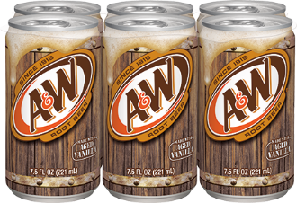
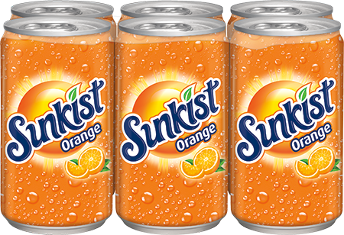
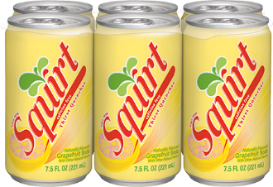
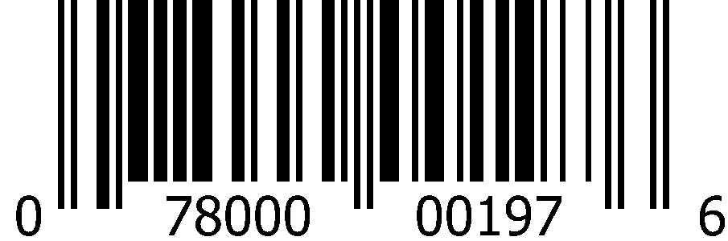
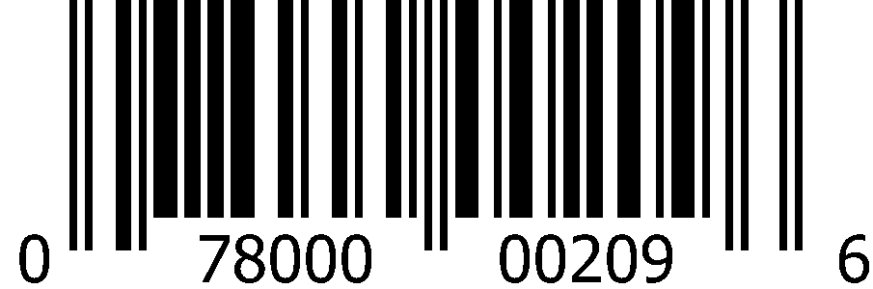
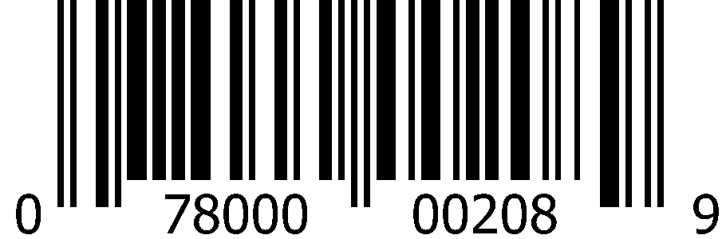
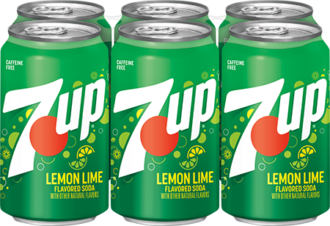
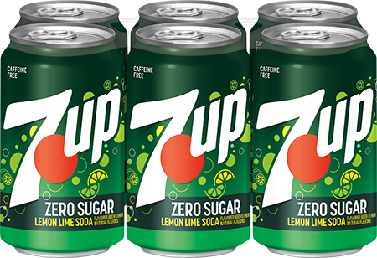
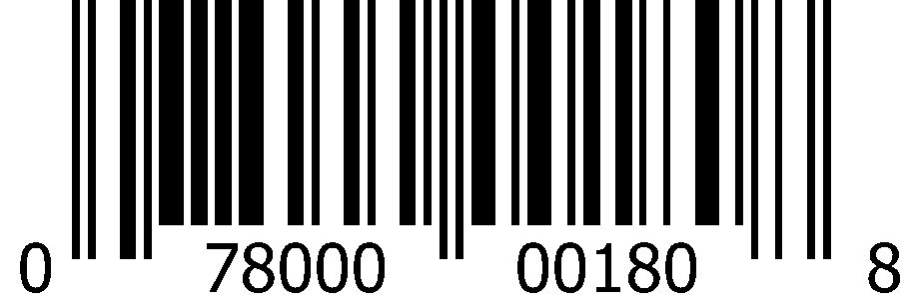
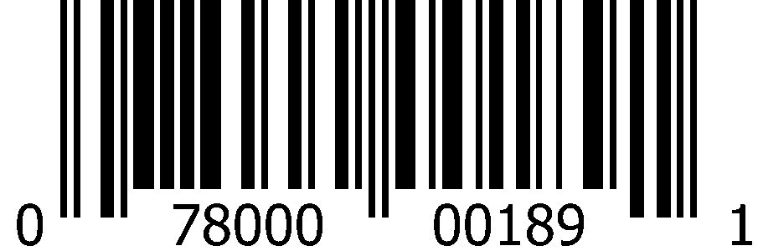
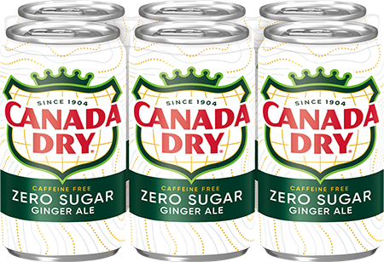
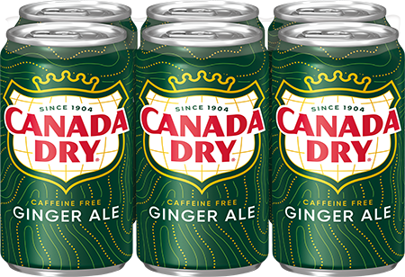
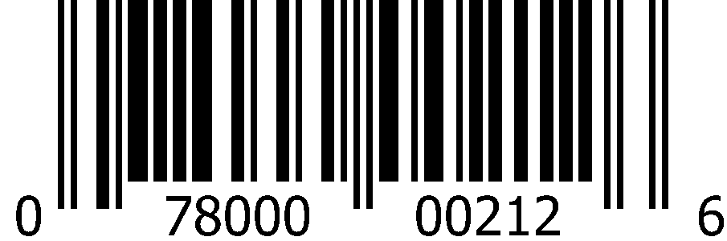
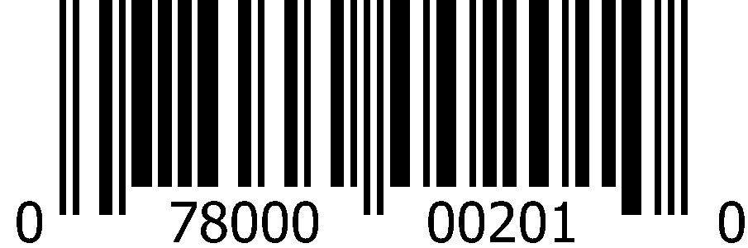
CSD 7.5oz Slim Cans (4x6pk)
 | A&W Root Beer |  | Sunkist Orange |  | Squirt
 | 1008 5415 |  | 1008 5423 |  | 1008 5424
 | 0-78000-00197-6 |  | 0-78000-00209-6 |  | 0-78000-00208-9
 | 7Up |  | 7Up Zero Sugar
 | 1008 5412 |  | 5413
 | 0-78000-00180-8 |  | 0-78000-00189-1
 | Canada Dry Ginger Ale Zero Sugar |  | Canada Dry Ginger Ale
 | 1008 6588 |  | 1008 5417
 | 0-78000-00212-6 |  | 0-78000-00201-0

Slide 5

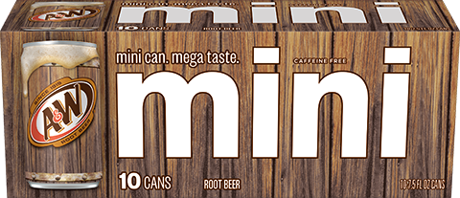
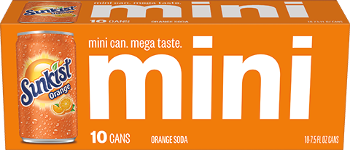
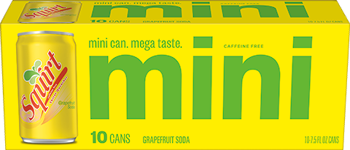
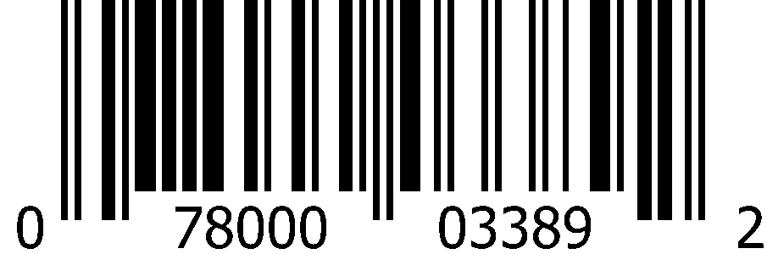
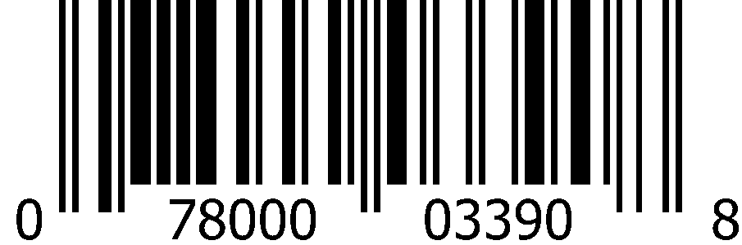
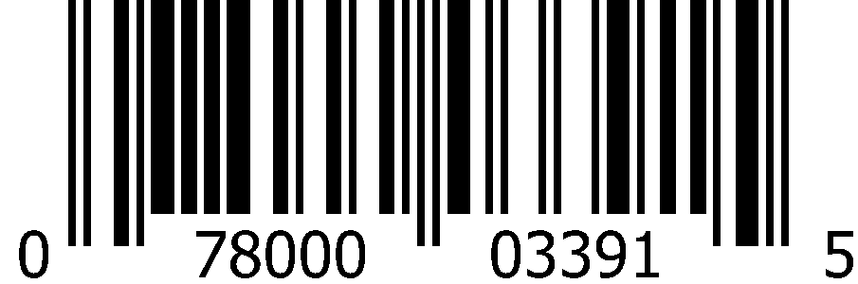
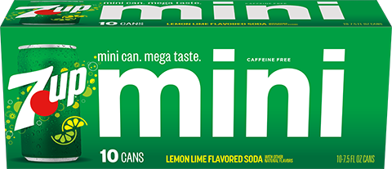
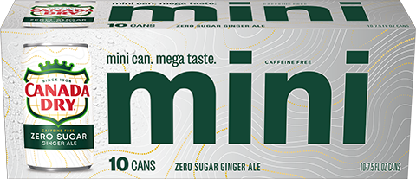
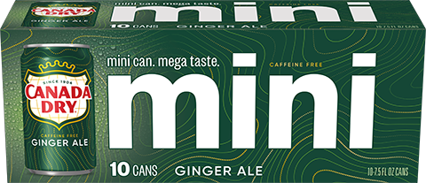
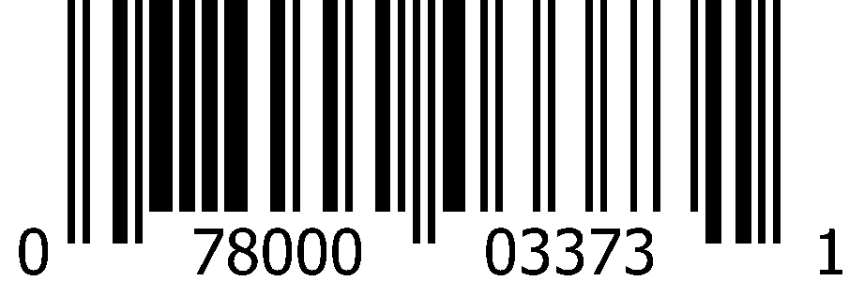

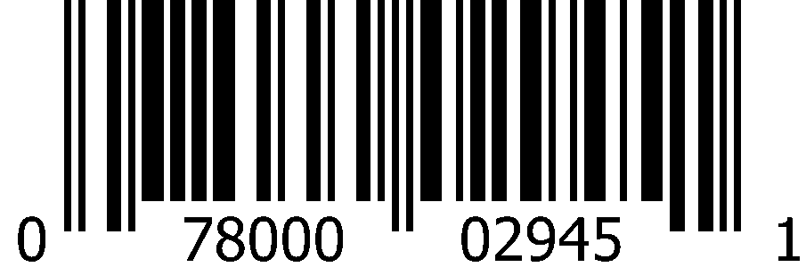
CSD 7.5oz Slim Cans (3x10pk)
 | A&W Root Beer |  | Sunkist Orange |  | Squirt
 | 1013 0141 |  | 1013 0142 |  | 1013 0144
 | 0-78000-03389-2 |  | 0-78000-03390-8 |  | 0-78000-03391-5
 | 7Up |  | Canada Dry Ginger Ale Zero Sugar |  | Canada Dry Ginger Ale
 | 1012 8315 |  | 1013 0140 |  | 1012 8316
 | 0-78000-03373-1 |  | 0-78000-03388-5 |  | 0-78000-02945-1

Slide 6

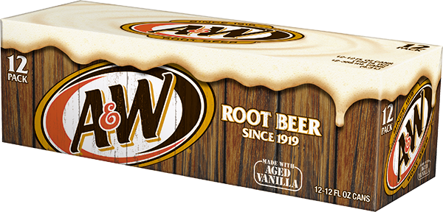
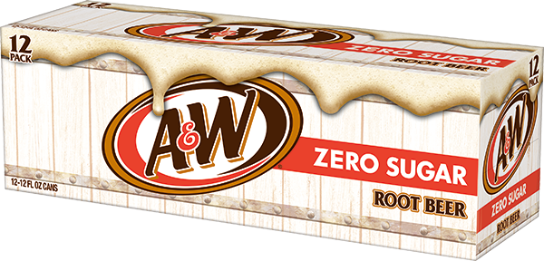
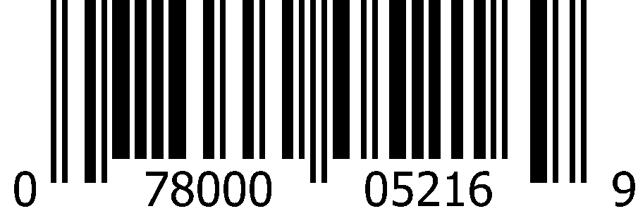
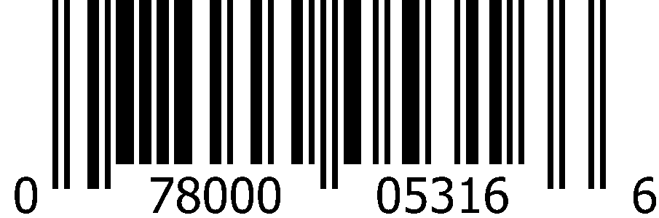
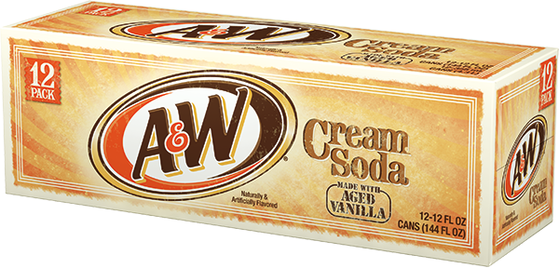
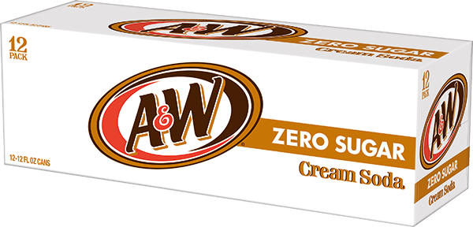
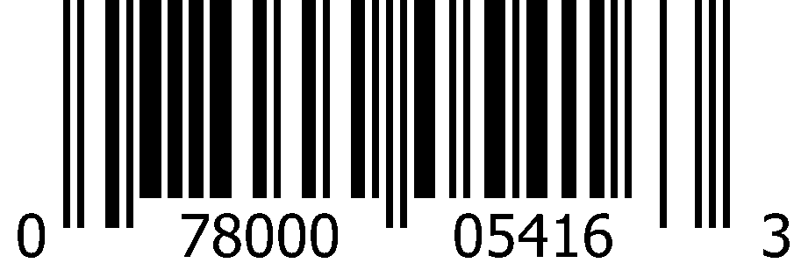
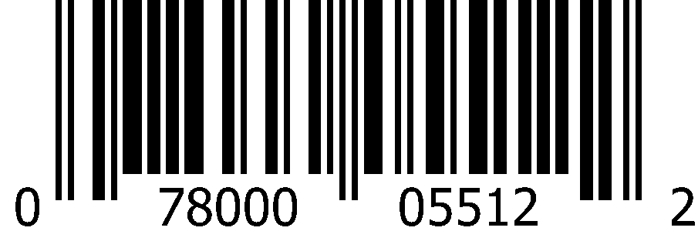
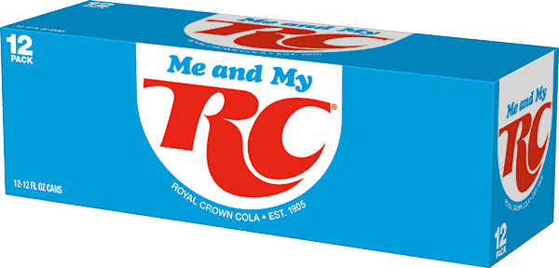
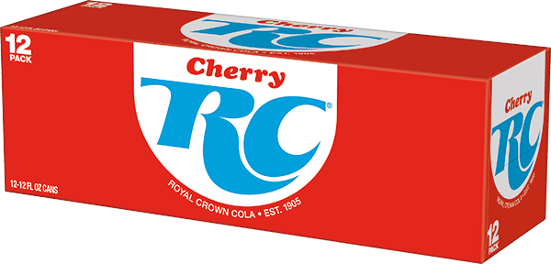
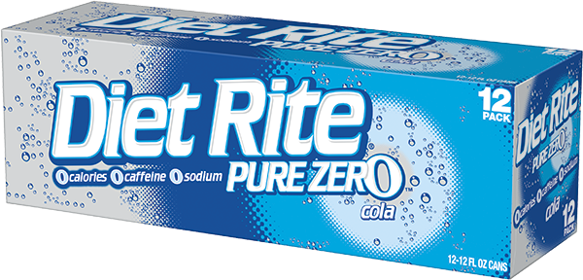

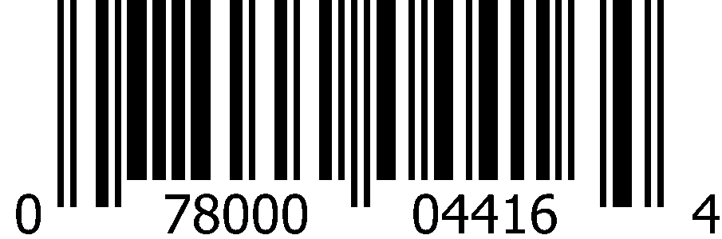
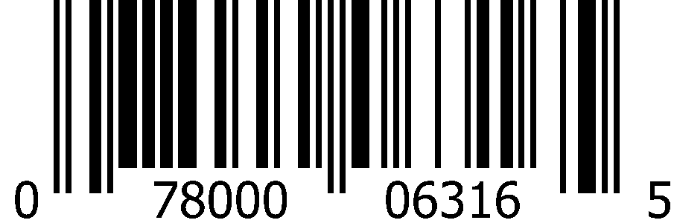
CSD 12oz Cans (2x12pk)
 | A&W Root Beer |  | A&W Root Beer Zero Sugar
 | 1000 0852 Deposit |  | 1000 0853
 | 0-78000-05216-9 |  | 0-78000-05316-6
 | A&W Cream Soda |  | A&W Cream Soda Zero Sugar
 | 1000 0831 |  | 1000 0832
 | 0-78000-05416-3 |  | 0-78000-05512-2
 | RC Cola |  | Cherry RC Cola |  | Diet Rite Cola
 | 1000 0838 |  | 1000 0179 |  | 1000 0842
 | 0-78000-04116-3 |  | 0-78000-04416-4 |  | 0-78000-06316-5

Slide 7

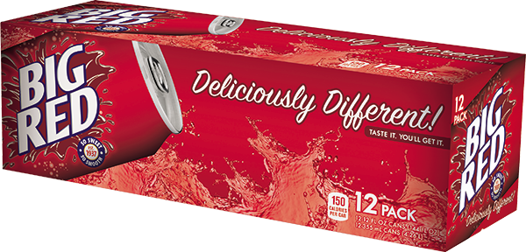
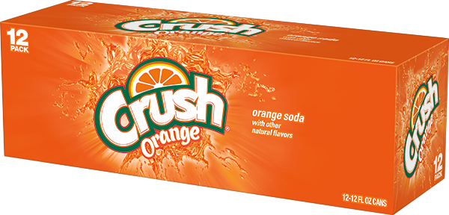
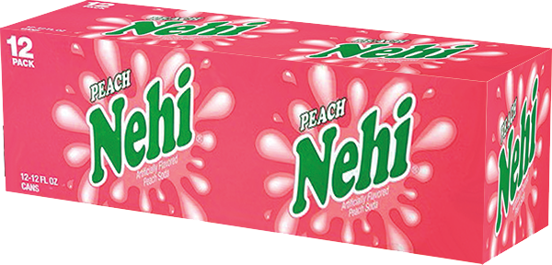
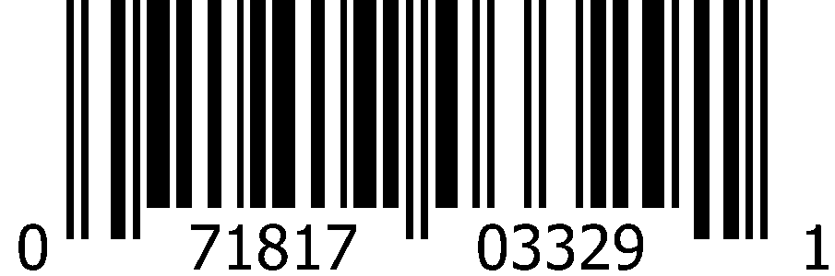
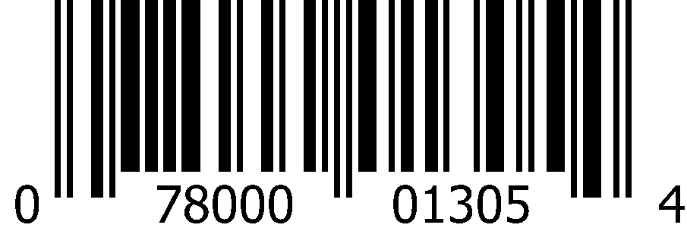
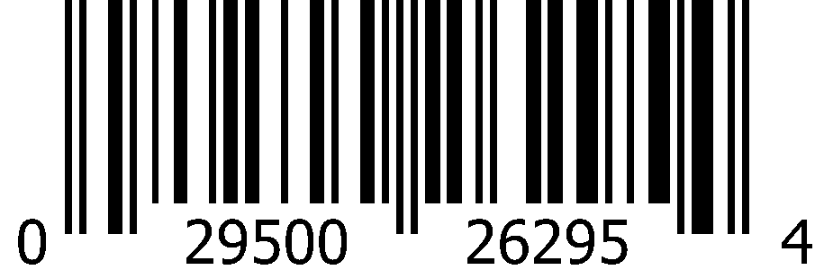
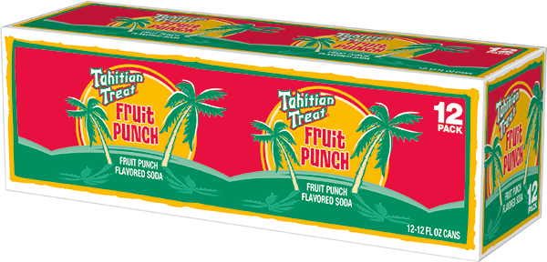
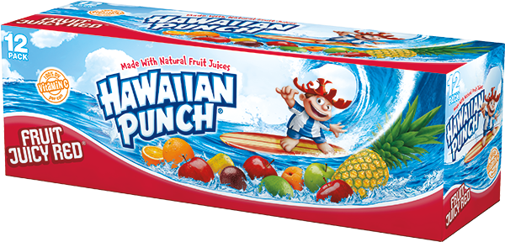
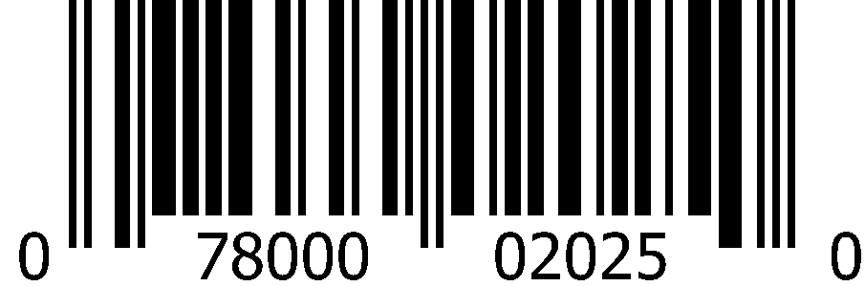
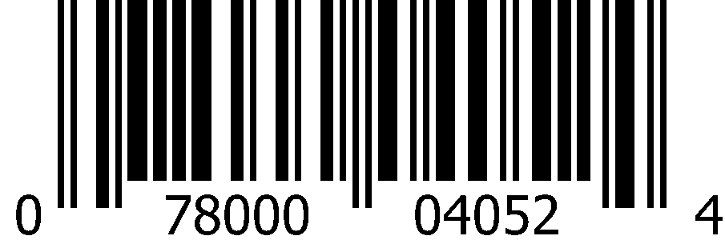
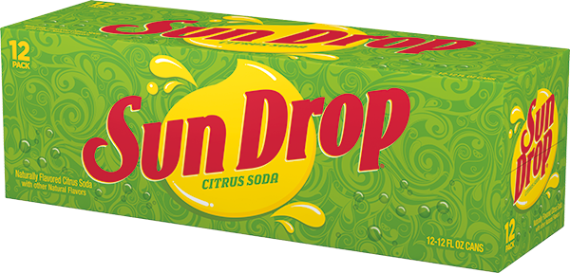
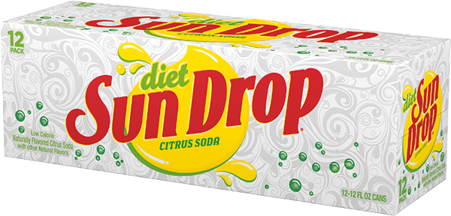








CSD 12oz Cans (2x12pk)
 | Big Red |  | Crush Orange |  | Nehi Peach
 | 1000 0862 |  | 1002 1944 |  | 1000 0180
 | 0-71817-03329-1 |  | 0-78000-01305-4 |  | 0-29500-26295-4
 | Tahitian Treat Fruit Punch |  | Hawaiian Punch Fruit Juicy Red
 | 1002 3856 |  | 1000 0855
 | 0-78000-02025-0 |  | 0-78000-04052-4
 | Sun Drop |  | Diet Sun Drop
 | 1000 0874 |  | 1000 0877
 | 0-78000-23016-1 |  | 0-78000-23116-8
 | Squirt |  | Squirt Zero Sugar |  | Ruby Red Squirt
 | 1000 0187 |  | 1000 0850 |  | 1000 0860
 | 0-78000-01616-1 |  | 0-78000-01716-8 |  | 0-78000-01816-5

Slide 8

















CSD 12oz Cans (2x12pk)
 | Sunkist Orange |  | Sunkist Orange Zero Sugar |  | Sunkist Strawberry Orange
 | 1000 0865 Deposit |  | 1000 0863 |  | 1015 8803
 | 0-78000-11316-7 |  | 0-78000-12216-9 |  | 0-78000-03850-7
 | Sunkist Berry Lemonade |  | Sunkist Watermelon Lemonade |  | Sunkist Mango Orange
 | 1013 7157 |  | 1015 4432 |  | 1014 2626
 | 0-78000-03555-1 |  | 0-78000-03772-2 |  | 0-78000-03633-6
 | Sunkist Strawberry Lemonade |  | Sunkist Cherry Limeade
 | 1012 0690 |  | 1000 0857
 | 0-78000-03176-8 |  | 0-78000-12116-2

Slide 9
















CSD 12oz Cans (2x12pk)
 | 7Up |  | 7Up Zero Sugar |  | Cherry 7Up
 | 1000 0829 Deposit |  | 1000 0830 Deposit |  | 0833
 | 0-78000-01180-7 |  | 0-78000-01181-4 |  | 0-78000-01182-1
 | Cherry 7Up Zero Sugar |  | 7Up Tropical |  | 7Up Tropical Zero Sugar
 | 1000 0834 |  | 6397 |  | 1015 6395
 | 0-78000-01188-3 |  | 0-78000-03798-2 |  | 0-78000-03818-7
 | 7Up Shirley Temple |  | 7Up Shirley Temple Zero Sugar
 | 1016 0484 |  | 1016 0483
 | 0-78000-03919-1 |  | 0-78000-03917-7

Slide 10














CSD 12oz Cans (2x12pk)
 | Canada Dry Cranberry Ginger Ale |  | Canada Dry Fruit Splash |  | Canada Dry Fruit Splash Zero Sugar
 | 1000 1994 |  | 1015 9681 |  | 1015 9680
 | 0-78000-15616-4 |  | 0-78000-03883-5 |  | 0-78000-03886-6
 | Canada Dry Ginger Ale Zero Sugar |  | Canada Dry Ginger Ale
 | 1000 0905 |  | 1000 0904
 | 0-78000-14816-9 |  | 0-78000-15216-6
 | Vernors Ginger Soda |  | Vernors Ginger Soda Zero Sugar
 | 1000 0840 |  | 1000 0841
 | 0-78000-18016-9 |  | 0-78000-18216-3

Slide 11

















CSD 12oz Cans (18pk)
 | A&W Root Beer |  | Sunkist Orange |  | Squirt
 | 1001 5572 |  | 1001 5439 |  | 1002 2368
 | 0-78000-05208-4 |  | 0-78000-11308-2 |  | 0-78000-01608-6
 | RC Cola |  | Cherry RC Cola
 | 1001 5532 |  | 1016 4706
 | 0-78000-01484-6 |  | 0-78000-03978-8
 | 7Up |  | Cherry 7up |  | Canada Dry Ginger Ale
 | 1001 5534 |  | 1016 4705 |  | 1001 5530
 | 0-78000-02002-1 |  | 0-78000-03977-1 |  | 0-78000-15208-1

Slide 12
















CSD 12oz Cans (24pk)
 | A&W Root Beer |  | RC Cola |  | Sunkist Orange
 | 1000 1044 |  | 1000 1039 |  | 1000 1048
 | 0-78000-05210-7 |  | 0-78000-04110-1 |  | 0-78000-11310-5
 | Sun Drop |  | Squirt
 | 1000 1049 |  | 1000 1043
 | 0-78000-23010-9 |  | 0-78000-01610-9
 | 7Up |  | 7Up Zero Sugar |  | Canada Dry Ginger Ale
 | 1000 1034 |  | 1000 1035 |  | 1000 6264
 | 0-78000-01214-9 |  | 0-78000-01234-7 |  | 0-78000-15210-4

Slide 13












CSD 16oz Cans (24pk)
 | A&W Root Beer |  | Sunkist Orange |  | 7Up |  | Canada Dry Ginger Ale
 | 1008 9269 |  | 1008 6430 |  | 1008 9301 |  | 1008 9257
 | 0-78000-05223-7 |  | 0-78000-11323-5 |  | 0-78000-00039-9 |  | 0-78000-02439-5
 | RC Cola |  | RC Berries and Cream
 | 1015 7739 |  | 1014 9170
 | 0-78000-04123-1 |  | 0-78000-03699-2

Slide 14














CSD 12oz Bellyband Bottles (3x8pk)
 | A&W Root Beer |  | Sunkist Orange |  | Squirt
 | 1000 2281 |  | 1000 2285 |  | 1002 8020
 | 0-78000-05288-6 |  | 0-78000-11388-4 |  | 0-78000-01688-8
 | 7Up |  | 7Up Zero Sugar
 | 1000 2282 |  | 1000 2283
 | 0-78000-01280-4 |  | 0-78000-01281-1
 | Canada Dry Ginger Ale Zero Sugar |  | Canada Dry Ginger Ale
 | 1008 3872 |  | 1004 5978
 | 0-78000-14888-6 |  | 0-78000-15288-3

Slide 15


















CSD 16.9oz Bottles (4x6pk)
 | A&W Root Beer |  | A&W Root Beer Zero Sugar |  | A&W Cream Soda
 | 1000 1251 |  | 1000 1252 |  | 1000 1238
 | 0-78000-05242-8 |  | 0-78000-05342-5 |  | 0-78000-05442-2
 | RC Cola |  | RC Berries and Cream |  | Diet Rite Cola
 | 1000 1242 |  | 1015 5292 |  | 1245
 | 0-78000-04142-2 |  | 0-78000-34234-5 |  | 0-78000-06342-4
 | Sunkist Orange |  | Sunkist Orange Zero Sugar |  | Crush Orange
 | 1000 1257 |  | 1000 1256 |  | 1002 1949
 | 0-78000-11342-6 |  | 0-78000-00676-6 |  | 0-78000-01325-2

Slide 16














CSD 16.9oz Bottles (4x6pk)
 | Sun Drop |  | Squirt |  | Squirt Zero Sugar
 | 1000 1263 |  | 1000 1249 |  | 1000 2165
 | 0-78000-23042-0 |  | 0-78000-00369-7 |  | 0-78000-00377-2
 | 7Up |  | 7Up Zero Sugar
 | 1000 1236 |  | 1000 1237
 | 0-78000-01219-4 |  | 0-78000-01223-1
 | Canada Dry Ginger Ale Zero Sugar |  | Canada Dry Ginger Ale
 | 1000 2576 |  | 1000 1266
 | 0-78000-14842-8 |  | 0-78000-00117-4

Slide 17























CSD 20oz Bottles (24pk)
 | A&W Root Beer |  | A&W Root Beer Zero Sugar |  | A&W Cream Soda |  | RC Cola
 | 1000 1096 |  | 1000 1122 |  | 1000 1109 |  | 1000 1111
 | 0-78000-05240-4 |  | 0-78000-05340-1 |  | 0-78000-05440-8 |  | 0-78000-04140-8
 | Crush Orange |  | Crush Strawberry |  | Crush Grape
 | 1002 1990 |  | 1002 1993 |  | 1002 1992
 | 0-78000-01328-3 |  | 0-78000-01369-6 |  | 0-78000-01352-8
 | Big Red |  | Tahitian Treat Fruit Punch |  | Sun Drop |  | Diet Sun Drop
 | 1000 1128 |  | 1002 7683 |  | 1000 1751 |  | 1000 1134
 | 0-71817-00037-8 |  | 0-78000-02040-3 |  | 0-78000-23040-6 |  | 0-78000-23140-3

Slide 18
















CSD 20oz Bottles (24pk)
 | Sunkist Orange |  | Sunkist Orange Zero Sugar
 | 1000 1130 |  | 1000 1129
 | 0-78000-11340-2 |  | 0-78000-12240-4
 | Sunkist Berry Lemonade |  | Sunkist Strawberry Orange |  | Sunkist Watermelon Lemonade
 | 1013 6557 |  | 1015 8804 |  | 1015 4433
 | 0-78000-03520-9 |  | 0-78000-03854-5 |  | 0-78000-03774-6
 | Sunkist Mango Orange |  | Sunkist Strawberry Lemonade |  | Sunkist Grape
 | 1014 2627 |  | 1012 0687 |  | 1000 1704
 | 0-78000-03636-7 |  | 0-78000-03178-2 |  | 0-78000-11640-3

Slide 19
















CSD 20oz Bottles (24pk)
 | Squirt |  | Squirt Zero Sugar |  | Ruby Red Squirt
 | 1000 1120 |  | 1000 1121 |  | 1000 1127
 | 0-78000-01640-6 |  | 0-78000-01740-3 |  | 0-78000-01840-0
 | 7Up |  | 7Up Zero Sugar |  | Cherry 7Up
 | 1000 1108 |  | 1000 1091 |  | 1000 1110
 | 0-78000-00161-7 |  | 0-78000-00162-4 |  | 0-78000-00554-7
 | Canada Dry Fruit Splash |  | Canada Dry Ginger Ale
 | 1015 9682 |  | 1000 1150
 | 0-78000-03888-0 |  | 0-78000-15240-1

Slide 20












CSD 1 Liter Bottles (15pk)
 | A&W Root Beer |  | RC Cola |  | Sunkist Orange
 | 1000 1323 |  | 1000 1319 |  | 1000 1332
 | 0-78000-05245-9 |  | 0-78000-00319-2 |  | 0-78000-11345-7
 | Squirt |  | 7Up |  | Canada Dry Ginger Ale
 | 1000 1322 |  | 1000 1315 |  | 1000 1335
 | 0-78000-01645-1 |  | 0-78000-00028-3 |  | 0-78000-15245-6

Slide 21








CSD 1.25 Liter Bottles (12pk)
 | A&W Root Beer |  | Squirt
 | 1010 7490 |  | 1010 7461
 | 0-78000-02657-3 |  | 0-78000-03069-3
 | 7Up |  | Canada Dry Ginger Ale
 | 1010 7491 |  | 1010 7539
 | 0-78000-02659-7 |  | 0-78000-01154-8

Slide 22












CSD 2 Liter Bottles (8pk)
 | A&W Root Beer |  | A&W Root Beer Zero Sugar |  | A&W Cream Soda
 | 1000 1437 |  | 1000 1438 |  | 1000 1417
 | 0-78000-05246-6 |  | 0-78000-05346-3 |  | 0-78000-05446-0
 | RC Cola |  | Diet Rite Cola |  | Tahitian Treat Fruit Punch
 | 1000 1424 |  | 1000 1426 |  | 1002 3918
 | 0-78000-00337-6 |  | 0-78000-06346-2 |  | 0-78000-02036-6

Slide 23














CSD 2 Liter Bottles (8pk)
 | Sunkist Orange |  | Sunkist Orange Zero Sugar |  | Sunkist Berry Lemonade |  | Sunkist Strawberry Lemonade
 | 1000 1455 |  | 1000 1454 |  | 1013 7158 |  | 1012 0686
 | 0-78000-11346-4 |  | 0-78000-12246-6 |  | 0-78000-03554-4 |  | 0-78000-03180-5
 | Crush Orange |  | Crush Grape |  | Crush Strawberry
 | 1002 1981 |  | 1002 1983 |  | 1002 1984
 | 0-78000-01336-8 |  | 0-78000-01356-6 |  | 0-78000-01371-9

Slide 24






















CSD 2 Liter Bottles (8pk)
 | Squirt |  | Squirt Zero Sugar |  | Ruby Red Squirt
 | 1000 1435 |  | 1000 1436 |  | 1000 0096
 | 0-78000-01646-8 |  | 0-78000-01746-5 |  | 0-78000-01846-2
 | 7Up |  | 7Up Zero Sugar |  | Cherry 7Up |  | Cherry 7Up Zero Sugar
 | 1000 1415 |  | 1000 1416 |  | 1000 1419 |  | 1000 1420
 | 0-78000-00034-4 |  | 0-78000-00075-7 |  | 0-78000-00531-8 |  | 0-78000-00831-9
 | 7Up Shirley Temple |  | Canada Dry Cranberry Ginger Ale |  | Canada Dry Ginger Ale Zero Sugar |  | Canada Dry Ginger Ale
 | 1016 0485 |  | 1000 1595 |  | 1000 1488 |  | 1000 1487
 | 0-78000-03921-4 |  | 0-78000-15646-1 |  | 0-78000-14846-6 |  | 0-78000-15246-3

Slide 25




















CSD 2 Liter $1.49 Bottles (8pk)
 | Sunkist Orange |  | Sunkist Berry Lemonade |  | Sunkist Strawberry Lemonade |  | Sunkist Cherry Limeade
 | 1016 1412 |  | 1016 1440 |  | 1016 1414 |  | 1016 1419
 | 0-78000-03957-3 |  | 0-78000-03964-1 |  | 0-78000-03970-2 |  | 0-78000-03969-6
 | Sunkist Strawberry |  | Sunkist Pineapple |  | Sunkist Peach
 | 1016 1427 |  | 1016 1439 |  | 1016 1411
 | 0-78000-03951-1 |  | 0-78000-03952-8 |  | 0-78000-03955-9
 | Tahitian Treat Fruit Punch |  | Cherry RC Cola |  | RC Cola
 | 1016 1415 |  | 1016 1418 |  | 1016 1426
 | 0-78000-03958-0 |  | 0-78000-03949-8 |  | 0-78000-03948-1

Slide 26




CSD Premium Glass
355mL Mexican Glass (12pk)
 | 7Up |  | Squirt
 | 2002 6451 |  | 2002 6453
 | 0-78000-01954-4 |  | 0-78000-01952-0

Slide 27













Stewart’s 12oz Glass Bottles (6x4pk)
 | Root Beer |  | Orange ‘n Cream |  | Black Cherry Wishniak
 | 1008 7165 |  | 1008 7163 |  | 1008 7166
 | 0-98794-00018-4 |  | 0-98794-00019-1 |  | 0-98794-00021-4
 | Root Beer |  | Orange ‘n Cream |  | Black Cherry Wishniak
 | 1008 7165 |  | 1008 7163 |  | 1008 7166
 | 0-98794-00026-9 |  | 0-98794-00027-6 |  | 0-98794-00029-0

Slide 28










CSD Fountain Syrup (2.5 gallon BIB)
 | 7Up |  | IBC Root Beer
 | 1000 0321 |  | 1000 1732
 | 0-78000-20011-9 |  | 0-88500-90224-6
 | Hawaiian Punch Fruit Juicy Red |  | Hawaiian Punch Lemonade
 | 1000 0329 |  | 1008 8270
 | 0-88500-90277-2 |  | 0-88500-00118-5
 | Sunkist Orange |  | Squirt |  | RC Cola
 | 1000 00327 |  | 1000 0232 |  | 1000 0261
 | 0-88500-90119-5 |  | 0-88500-90171-3 |  | 0-88500-90248-2

Slide 29















Canada Dry Mixers
1 Liter Bottles (15pk)
 | Tonic Water |  | Tonic Water Zero Sugar |  | Club Soda
 | 1000 0071 |  | 1000 1334 |  | 1000 1336
 | 0-78000-15345-3 |  | 0-78000-14945-6 |  | 0-78000-14645-5
10oz PET Bellyband Bottles (4x6pk)
 | Tonic Water |  | Tonic Water Zero Sugar
 | 1011 4958 |  | 1011 4953
 | 0-78000-00365-9 |  | 0-78000-00342-0
 | Ginger Ale |  | Club Soda
 | 1011 4954 |  | 1011 4955
 | 0-78000-00364-2 |  | 0-78000-00341-3

Slide 30






Canada Dry 7.5oz Slim Cans (4x6pk)
 | Tonic Water |  | Tonic Water Zero Sugar |  | Club Soda
 | 1016 0714 |  | 1016 0704 |  | 1016 0712
 | 0-78000-00224-9 |  | 0-78000-00225-6 |  | 0-78000-00223-2

Slide 31

























Polar Seltzer 12oz Cans (3x8pk)
 | Black Cherry |  | Cranberry Lime |  | Lime
 | 1013 8355 |  | 1013 8361 |  | 1013 8365
 | 0-71537-00366-6 |  | 0-71537-00364-2 |  | 0-71537-00367-3
 | Original |  | Orange Vanilla |  | Raspberry Lime
 | 1013 8360 |  | 1015 2004 |  | 1013 8362
 | 0-71537-00365-9 |  | 0-71537-30161-8 |  | 0-71537-00363-5
 | Ruby Red Grapefruit |  | Blackberry Mango |  | Strawberry Watermelon
 | 1013 8357 |  | 1016 0447 |  | 1015 5919
 | 0-71537-00368-0 |  | 0-71537-30382-7 |  | 0-71537-30389-6
 | Ginger Lime Mule |  | Lemon |  | Pink Apple & Lemon
 | 1015 2006 |  | 1015 2002 |  | 1014 9358
 | 0-71537-00326-0 |  | 0-71537-30134-2 |  | 0-71537-00374-1

Slide 32













Polar Seltzer’ade 12oz Cans (3x8pk)
 | Tart Cherry Lemonade |  | Raspberry Pink Lemonade |  | Blood Orange Lemonade
 | 1013 8364 |  | 1013 8354 |  | 1013 8351
 | 0-71537-30147-2 |  | 0-71537-30164-9 |  | 0-71537-00360-4
 | Blueberry Lemonade |  | Mango Limeade |  | Coconut Limeade
 | 1013 8353 |  | 1013 8352 |  | 1013 8350
 | 0-71537-00377-2 |  | 0-71537-00375-8 |  | 0-71537-00357-4

Slide 33










Polar Seltzer 2024 12oz Cans (4x6pk)
 | Raspberry Limoncello |  | Seaside Watermelon Punch |  | Strawberry Creme
 | 1015 8004 |  | 1015 8002 |  | 1016 1533
 | 0-71537-41155-3 |  | 0-71537-41156-0 |  | 0-71537-41160-7
 | Peach Iced Tea |  | Papaya Breeze
 | 1016 1532 |  | 1016 1534
 | 0-71537-41162-1 |  | 0-71537-41161-4

Slide 34






Polar Seltzer 20oz Bottles (24pk)
 | Black Cherry |  | Lemon |  | Ruby Red Grapefruit
 | 1013 8421 |  | 1013 8424 |  | 1013 8422
 | 0-71537-06028-7 |  | 0-71537-06034-8 |  | 0-71537-06025-6

Slide 35














Polar Seltzer 1L Bottles (12pk)
 | Raspberry Lime |  | Lime |  | Black Cherry
 | 1013 8390 |  | 1013 8406 |  | 1013 8391
 | 0-71537-02030-4 |  | 0-71537-02035-9 |  | 0-71537-02028-1
 | Original |  | Mandarin
 | 1013 8414 |  | 1013 8407
 | 0-71537-02020-5 |  | 0-71537-02044-1
 | Blueberry Lemonade |  | Ruby Red Grapefruit
 | 1013 8395 |  | 1013 8409
 | 0-71537-02040-3 |  | 0-71537-02025-0

Slide 36







Core Hydration+ 23.9oz Bottles (12pk)
 | Immunity Lemon Extract |  |  | Vibrance Pink Grapefruit Extract |  |  | Calm Cucumber Extract
 | 1014 2608 |  |  | 1014 2610 |  |  | 1014 2609
 | 8-19858-02060-9 |  |  | 8-19858-02064-7 |  |  | 8-19858-02062-3

Slide 37























Bai 18oz Bottles (12pk)
 | Molokai Coconut |  | Puna Coconut Pineapple |  | Madagascar Coconut Mango
 | 1015 9894 |  | 1015 9895 |  | 1015 9966
 | 8-13694-02671-9 |  | 8-13694-02673-3 |  | 8-13694-02677-1
 | Brasilia Blueberry |  | Kula Watermelon |  | Kupang Strawberry Kiwi |  | Zambia Bing Cherry
 | 1015 9908 |  | 1015 9909 |  | 1016 0135 |  | 1015 9911
 | 8-13694-02665-8 |  | 8-13694-02669-6 |  | 8-13694-02690-0 |  | 8-13694-02667-2
 | Costa Rica Clementine |  | Pilavo Pineapple Mango |  | Rubi Raspberry Lemon Lime |  | São Paulo Strawberry Lemonade
 | 1016 0136 |  | 1015 9905 |  | 1015 9305 |  | 1016 0140
 | 8-13694-02688-7 |  | 8-13694-02675-7 |  | 8-13694-02639-9 |  | 8-13694-02693-1

Slide 38
















Bai 14oz Bottles (2x6pk)
 | Molokai Coconut |  | Puna Coconut Pineapple
 | 1015 9732 |  | 1015 9735
 | 8-13694-02656-6 |  | 8-13694-02657-3
 | Brasilia Blueberry |  | Kula Watermelon |  | Zambia Bing Cherry
 | 1015 9734 |  | 1015 9731 |  | 1015 9733
 | 8-13694-02653-5 |  | 8-13694-02655-9 |  | 8-13694-02654-2
 | Pilavo Pineapple Mango |  | Rubi Raspberry Lemon Lime |  | São Paulo Strawberry Lemonade
 | 1015 9736 |  | 1015 9303 |  | 1016 0134
 | 8-13694-02658-0 |  | 8-13694-02642-9 |  | 8-13694-02686-3

Slide 39




Bai Boost 18oz Bottles (12pk)
 | Buku Black Raspberry |  | Watamu Strawberry Watermelon
 | 1013 6890 |  | 1013 6892
 | 8-13694-02577-4 |  | 8-13694-02581-1

Slide 40













Snapple Elements 15.9oz Bottles (12pk)
 | Rain Agave Cactus |  | Fire Dragon Fruit |  | Air Prickly Pear & Peach White Tea
 | 1013 6657 |  | 1013 6656 |  | 1013 6653
 | 0-76183-00849-2 |  | 0-76183-00843-0 |  | 0-76183-00834-8
 | Earth Cherry & Fig Black Tea |  | Sun Starfruit, Orange & Nectarine |  | Moon Spiced Plum & Lime Oolong Tea
 | 1015 1591 |  | 1015 8173 |  | 1015 9521
 | 0-76183-00898-0 |  | 0-76183-00907-9 |  | 0-76183-00918-5

Slide 41







Snapple 8oz PET Bottles (2x8pk)
 | Peach Tea
 | 1015 9535
 | 0-76183-00923-9
 | Kiwi Strawberry |  | Snapple Apple
 | 1015 8700 |  | 1015 8699
 | 0-76183-00909-3 |  | 0-76183-00911-6

Slide 42






















Snapple 16oz PET Bottles (12pk)
 | Peach Tea |  | Zero Sugar Peach Tea |  | Zero Sugar Raspberry Tea |  | Half ‘n Half Lemonade Iced Tea
 | 1013 6509 |  | 1013 6532 |  | 1013 6533 |  | 1013 6504
 | 0-76183-00311-4 |  | 0-76183-00314-5 |  | 0-76183-00321-3 |  | 0-76183-00316-9
 | Kiwi Strawberry |  | Mango Madness |  | Fruit Punch |  | Snapple Apple
 | 1013 6515 |  | 1013 6517 |  | 1013 6514 |  | 1013 6538
 | 0-76183-00310-7 |  | 0-76183-00312-1 |  | 0-76183-00313-8 |  | 0-76183-00328-2
 | Zero Sugar Kiwi Strawberry |  | Zero Sugar Snapple Apple |  | Watermelon Lemonade
 | 1014 2662 |  | 1015 1585 |  | 1013 6470
 | 0-76183-00870-6 |  | 0-76183-00893-5 |  | 0-76183-45512-8

Slide 43














Snapple 16oz PET Bottles (4x6pk)
 | Peach Tea |  | Zero Sugar Peach Tea
 | 1013 7150 |  | 1013 7149
 | 0-76183-00766-2 |  | 0-76183-00774-7
 | Raspberry Tea |  | Zero Sugar Raspberry Tea
 | 1013 6494 |  | 1013 6570
 | 0-76183-00768-6 |  | 0-76183-00817-1
 | Half ‘n Half Lemonade Iced Tea |  | Zero Sugar Half ‘n Half Lemonade Iced Tea |  | Zero Sugar Trop-A-Rocka
 | 1013 6529 |  | 1013 6475 |  | 1013 6571
 | 0-76183-00820-1 |  | 0-76183-00798-3 |  | 0-76183-00822-5

Slide 44








Snapple 16oz PET Bottles (4x6pk)
 | Kiwi Strawberry |  | Zero Sugar Kiwi Strawberry
 | 1013 7148 |  | 1014 2664
 | 0-76183-00777-8 |  | 0-76183-00873-7
 | Snapple Apple |  | Zero Sugar Snapple Apple
 | 1013 7145 |  | 1015 1583
 | 0-76183-00771-6 |  | 0-76183-00896-6

Slide 45








Snapple 16oz PET Bottles (2x12pk)
 | Peach Tea |  | Zero Sugar Peach Tea
 | 1013 6526 |  | 1013 6481
 | 0-76183-00783-9 |  | 0-76183-00813-3
 | Kiwi Strawberry |  | Snapple Apple
 | 1013 6572 |  | 1013 6569
 | 0-76183-00776-1 |  | 0-76183-00824-9

Slide 46












Snapple 32oz PET Bottles (12pk)
 | Peach Tea |  | Zero Sugar Peach Tea
 | 1000 3023 |  | 1000 3024
 | 0-76183-32356-4 |  | 0-76183-32357-1
 | Kiwi Strawberry |  | Mango Madness |  | Fruit Punch |  | Snapple Apple
 | 1000 3025 |  | 1000 3037 |  | 1000 3038 |  | 1008 8249
 | 0-76183-32363-2 |  | 0-76183-32364-9 |  | 0-76183-32372-4 |  | 0-76183-32850-7

Slide 47










Snapple 64oz PET Bottles (8pk)
 | Peach Tea |  | Zero Sugar Peach Tea |  | Zero Sugar Half ‘n Half Lemonade Iced Tea
 | 1000 2904 |  | 1000 2905 |  | 1001 4793
 | 0-76183-64356-3 |  | 0-76183-64357-0 |  | 0-76183-00022-9
 | Kiwi Strawberry |  | Snapple Apple
 | 1000 2906 |  | 1008 8248
 | 0-76183-64363-1 |  | 0-76183-64387-7

Slide 48










Yoo-hoo / Clamato
 | Chocolate 15.5oz Glass (24pk) |  | Chocolate 12oz Glass (6x4pk)
 | 1000 6323 |  | 1000 6325
 | 0-72350-00011-5 |  | 0-72350-02054-0
 | Chocolate 11oz Cans (4x6pk)
 | 1000 6598
 | 0-72350-00007-8
Clamato 32oz PET (12pk)
 | Original 32oz PET
 | 1001 1920
 | 0-14800-51324-0

Slide 49















La Colombe 11oz Cans (12pk)
 | Triple Draft Latte |  | Vanilla Draft Latte |  | Oatmilk Vanilla Draft Latte
 | 2003 5333 |  | 2003 5332 |  | 2003 5325
 | 6-04913-00488-1 |  | 6-04913-00490-4 |  | 6-04913-00520-8
 | Mocha Draft Latte |  | Caramel Draft Latte
 | 2003 5334 |  | 2003 5767
 | 6-04913-00489-8 |  | 6-04913-00491-1
 | Double Draft Latte |  | Black Cold Brew
 | 2003 5765 |  | 2003 5763
 | 6-04913-00530-7 |  | 6-04913-00534-5

Slide 50










La Colombe 9oz Cans (4x4pk)
 | Vanilla Draft Latte |  | Triple Draft Latte |  | Mocha Draft Latte
 | 2003 5324 |  | 5323 |  | 2003 5326
 | 6-04913-00015-9 |  | 6-04913-00016-6 |  | 6-04913-00014-2
 | Oatmilk Vanilla Draft Latte |  | Caramel Draft Latte
 | 2003 5330 |  | 5764
 | 6-04913-00268-9 |  | 6-04913-00094-4

Slide 51





























Electrolit 21oz bottles (12pk)
 | Grape |  | Strawberry Kiwi |  | Fruit Punch
 | 2003 5821 |  | 2003 5823 |  | 2003 5831
 | 8-87725-00000-9 |  | 8-87725-00025-2 |  | 8-87725-00045-0
 | Coconut |  | Blue Raspberry |  | Orange
 | 2003 5818 |  | 2003 5837 |  | 2003 5819
 | 8-87725-00004-7 |  | 8-87725-00130-3 |  | 8-87725-00005-4
 | Lemon Lime |  | Cucumber Lime |  | Berry Bliss |  | Strawberry
 | 2003 5824 |  | 2003 5827 |  | 2003 5830 |  | 2003 5822
 | 8-87725-00006-1 |  | 8-87725-00097-9 |  | 8-87725-00043-6 |  | 8-87725-00003-0
 | Zero Strawberry Banana |  | Zero Blue Raspberry |  | Zero Berry Blast |  | Green Apple
 | 2003 5841 |  | 2003 5833 |  | 2003 5834 |  | 2003 5840
 | 8-87725-00129-7 |  | 8-87725-00128-0 |  | 8-87725-00086-3 |  | 8-87725-00177-8

Slide 52
















Electrolit 21oz bottles (12pk)
 | Mango |  | Passion Fruit |  | Hibiscus - Jamaica |  | Horchata
 | 2003 5832 |  | 2003 5829 |  | 2003 5828 |  | 2003 5826
 | 8-87725-00136-5 |  | 8-87725-00042-9 |  | 8-87725-00041-2 |  | 8-87725-00084-9
 | Zero Fruit Punch Splash |  | Zero Lemon Breeze
 | 2003 5839 |  | 2003 5835
 | 8-87725-00065-8 |  | 8-87725-00070-2
 | Pineapple |  | Watermelon Lime
 | 2003 5838 |  | 2003 5842
 | 8-87725-00139-6 |  | 8-87725-00180-8

Slide 53

























C4 Performance Energy 16oz Cans (12pk)
 | Frozen Bombsicle |  | Strawberry Watermelon Ice |  | Orange Slice |  | Midnight Cherry
 | 2003 4426 |  | 2003 4435 |  | 2003 4441 |  | 2003 4444
 | 8-42595-10659-6 |  | 8-42595-10657-2 |  | 8-42595-10936-8 |  | 8-42595-11109-5
 | Arctic Snow Cone |  | Popsicle Cherry |  | Popsicle Hawaiian Pineapple |  | Popsicle Grape
 | 2003 4434 |  | 2003 5283 |  | 2003 5284 |  | 2003 5281
 | 8-42595-11885-8 |  | 8-42595-13125-3 |  | 8-42595-13129-1 |  | 8-42595-13127-7
 | Creamsicle |  | Starburst Strawberry |  | Skittles |  | Mango Foxtrot
 | 2003 5742 |  | 2003 4425 |  | 2003 4450 |  | 2003 4447
 | 8-42595-13162-8 |  | 8-42595-12175-9 |  | 8-42595-12176-6 |  | 8-42595-12619-8

Slide 54












C4 Performance Energy 12oz Cans (6x4pk)
 | Frozen Bombsicle |  | Strawberry Watermelon Ice |  | Popsicle Cherry
 | 2003 4424 |  | 2003 4418 |  | 2003 5285
 | 8-42595-11304-4 |  | 8-42595-11756-1 |  | 8-42595-13144-4
 | Skittles |  | Starburst Strawberry
 | 2003 4446 |  | 2003 4415
 | 8-42595-12783-6 |  | 8-42595-12784-3
C4 Performance Energy Variety Pack 12oz Cans (12pk)
 | Popsicle Variety Pack
 | 2003 5287
 | 8-42595-13297-7

Slide 55













C4 Smart Energy 12oz Cans (12pk)
 | Strawberry Guava |  | Peach Mango |  | Cherry Berry Lime
 | 2003 4412 |  | 2003 4420 |  | 2003 4413
 | 8-42595-12692-1 |  | 8-42595-11708-0 |  | 8-42595-11983-1
 | Blood Orange Yuzu |  | Watermelon Burst |  | Tropical Passionfruit
 | 2003 4410 |  | 2003 4448 |  | 2003 4416
 | 8-42595-12690-7 |  | 8-42595-12509-2 |  | 8-42595-12686-0

Slide 56






C4 Smart Energy 12oz Cans (6x4pk)
 | Strawberry Guava |  | Cherry Berry Lime
 | 2003 5275 |  | 2003 5277
 | 8-42595-12845-1 |  | 8-42595-11984-8
C4 Smart Energy Variety Pack 12oz Cans (12pk)
 | Variety Pack
 | 2003 5279
 | 8-42595-13139-0

Slide 57













C4 Ultimate Energy 16oz Cans (12pk)
 | Ultimate Arctic Snow Cone |  | Ultimate Fruit Punch |  | Ultimate Orange Cream |  | Ultimate Freedom Ice
 | 2003 4437 |  | 2003 4440 |  | 2003 4433 |  | 2003 4443
 | 8-42595-10661-9 |  | 8-42595-12165-0 |  | 8-42595-12702-7 |  | 8-42595-12763-8
 | Ultimate Berry Powerbomb |  | Ultimate Ruthless Raspberry
 | 2003 5274 |  | 2003 5278
 | 8-42595-12959-5 |  | 8-42595-12960-1

Slide 58









A Shoc 16oz Cans (12pk)
 | Tropical Punch |  |  | Swirl Pop
 | 2003 3888 |  |  | 2003 4301
 | 8-10014-53063-5 |  |  | 8-10014-53038-3
 | Blue Raspberry |  |  | Watermelon
 | 2003 1731 |  |  | 2002 9372
 | 8-10014-53034-5 |  |  | 8-10014-53017-8

Slide 59



















A Shoc Accelerator 12oz Cans (12pk)
 | Rocket Pop |  | Cherry Ice Pop |  | Island Guava
 | 2003 4298 |  | 2003 5171 |  | 2003 3660
 | 8-10014-53068-0 |  | 8-10014-53073-4 |  | 8-10014-53047-5
 | Cherry Limeade |  | Tropical Punch |  | Peach Paradise
 | 2003 3658 |  | 2003 5172 |  | 2003 4299
 | 8-10014-53049-9 |  | 8-10014-53071-0 |  | 8-10014-53031-4
 | Berry Lemonade |  | Orange Mango |  | Star Berry
 | 2003 4300 |  | 2003 3657 |  | 2003 4297
 | 8-10014-53054-3 |  | 8-10014-53048-2 |  | 8-10014-53067-3

Slide 60











XYience 16oz Cans (12pk)
 | Cherry Lime |  |  | Mango Guava |  |  | Frostberry
 | 1012 0848 |  |  | 1012 0844 |  |  | 1012 0846
 | 8-42885-09821-1 |  |  | 8-42885-09871-6 |  |  | 8-42885-09715-3
 | Fruit Punch |  |  | Fuji Apple
 | 1012 0842 |  |  | 1012 0841
 | 8-42885-09726-9 |  |  | 8-42885-00007-8

Slide 61













Venom 16oz Cans (24pk)
 | Original |  | Mango |  | Fruit Punch |  | Black Cherry Kiwi
 | 1014 6508 |  | 1014 6510 |  | 1014 6509 |  | 1014 6511
 | 0-78000-02374-9 |  | 0-78000-02376-3 |  | 0-78000-02375-6 |  | 0-78000-02868-3
 | Original Zero Sugar |  | Strawberry Apple Zero Sugar
 | 1014 6512 |  | 1014 6515
 | 0-78000-02377-0 |  | 0-78000-01346-7

Slide 62

















Vita Coco 500mL Tetra Pak (12pk)
 | Original |  | Pineapple |  | Peach & Mango
 | 2000 0642 |  | 2000 0643 |  | 2000 0644
 | 8-98999-01000-7 |  | 8-98999-03000-5 |  | 8-98999-04000-4
 | Pressed Coconut |  | Pure Farmer’s Organic
 | 2002 6703 |  | 2003 4309
 | 8-98999-01014-4 |  | 8-98999-01226-1
500mL Tetra Pak (6x4pk)
 | Original |  | Pressed Coconut |  | Pineapple
 | 2000 7583 |  | 2003 1761 |  | 2003 3809
 | 8-98999-01200-1 |  | 8-98999-01185-1 |  | 8-98999-01221-6

Slide 63












Vita Coco 1 Liter Tetra Pak (12pk)
 | Original |  | Pineapple |  | Pressed Coconut |  | Pure Farmer’s Organic
 | 2000 0631 |  | 2002 0822 |  | 2002 8242 |  | 2003 2453
 | 8-98999-00050-3 |  | 8-98999-00618-5 |  | 8-98999-01128-8 |  | 8-98999-00099-2
Multi packs
 | Pure (4x4pk) |  | 330mL Pure 12pk
 | 2002 3029 |  | 2002 8021
 | 8-98999-00001-5 |  | 8-98999-00690-1

Slide 64










Vita Coco 16.9oz PET Bottles (12pk)
 | Original |  | Pineapple |  | Pressed Coconut
 | 2002 8241 |  | 2003 4310 |  | 2002 8240
 | 8-98999-01022-9 |  | 8-98999-01285-8 |  | 8-98999-01124-0
Coconut Juice 16.4oz Can (12pk)
 | Coconut Juice with Pulp |  | Coconut Juice with Mango
 | 2003 3902 |  | 2003 3901
 | 8-98999-01269-8 |  | 8-98999-01270-4

Slide 65













Peñafiel 600mL Bottles (12pk)
 | Agua Mineral Water |  | Limonada Limeade |  | Naranjada Orangeade
 | 2002 0466 |  | 2002 0468 |  | 2002 0470
 | 0-78000-20024-9 |  | 0-78000-20028-7 |  | 0-78000-20027-0
 | Piñada Pineappleade |  | Toronja Grapefruitade |  | Manzanita Apple
 | 2002 6469 |  | 2003 5169 |  | 2002 0467
 | 0-78000-03091-4 |  | 0-78000-03891-0 |  | 0-78000-20025-6

Slide 66

















evian Natural Spring Water
 | 500 mL (24pk) |  | 750 mL Sport Cap (12pk) |  | 1 Liter (12pk)
 | 2002 8337 |  | 2002 8336 |  | 2002 8335
 | 0-79298-00008-5 |  | 0-79298-40011-3 |  | 0-79298-00007-8
 | 1.5 Liter (12pk) |  | 1.5 L (1x6pk)
 | 2002 8330 |  | 2003 1920
 | 0-79298-00005-4 |  | 0-79298-51006-5
 | 330 mL (4x6pk) |  | 500 mL (4x6pk) |  | 1 Liter (2x6pk)
 | 2002 8333 |  | 2002 8331 |  | 2002 8329
 | 0-79298-00017-7 |  | 0-79298-00019-1 |  | 0-79298-60007-0

Slide 67















Core Hydration
 | 20oz (24pk) |  | 23.9oz Sport Cap (24pk) |  | 30.4oz (12pk) |  | 1.3L (12pk)
 | 1012 3486 |  | 1012 3484 |  | 1012 3487 |  | 1012 3488
 | 8-53004-00402-0 |  | 8-53004-00495-2 |  | 8-53004-00403-7 |  | 8-53004-00489-1
 | 16.9oz (4x6pk) |  | 30.4oz (2x6pk) |  | 30.4oz (1x12pk)
 | 1012 3483 |  | 1012 3485 |  | 1015 4420
 | 8-53004-00454-9 |  | 8-19858-02002-9 |  | 8-19858-02075-3

Slide 68











Deja Blue
 | 12oz (24pk) |  | 20oz (24pk) |  | 1L Deja Blue (15pk)
 | 1000 0237 |  | 1000 0252 |  | 1000 1633
 | 0-78000-09256-1 |  | 0-78000-09240-0 |  | 0-78000-09245-5
 | 16.9oz (4x6pk) |  | 16.9oz (24pk)
 | 1000 0239 |  | 1000 0246
 | 0-78000-09242-4 |  | 0-78000-80096-8

Slide 69










2024 KDP Cold Beverage
Plains Region Portfolio
©2024 GRI Multi Media
Design, layout and content creation by Jonathan Grimm
Jonathan.Grimm@kdrp.com

